Slide 1

Lysosomal Storage Disorders
Mechanism of Disease
MSL Name
©2023 Genzyme Corporation. All rights reserved. Sanofi is a registered trademark of Sanofi or an affiliate.
MAT-US-2306240 v1.0 – P
Expiration Date: 08/14/2025
For use by Sanofi Medical Affairs for scientific and medical discussions only. Do not photograph, copy or distribute.
1
Notes:
• This is an internal training deck that provides an overview of the pathophysiology underlying several lysosomal storage disorders (LSDs) and the mechanism of action of Venglustat, an investigational therapy being studied for the treatment of the LSDs GM2 gangliosidoses, Fabry disease, and Gaucher disease types 1 and 3

Slide 2
Notice
This program is non-promotional and sponsored by Sanofi.
The content contained in this presentation was developed by Sanofi and is not eligible for continuing medical education (CME) credits.
For use by Sanofi Medical Affairs for scientific and medical discussions only. Do not photograph, copy or distribute.
MAT-US-2306240 v1.0 – P
Expiration Date: 08/14/2025
2

Slide 3
Objectives
Describe and discuss the:
Role of glycosphingolipids (GSLs) in the mechanism
of disease of lysosomal storage disorders (LSDs), including GM2 gangliosidoses, Fabry disease, and Gaucher disease
Potential damage caused by GSL accumulation in cells and tissues
MAT-US-2306240 v1.0 – P
Expiration Date: 08/14/2025
For use by Sanofi Medical Affairs for scientific and medical discussions only. Do not photograph, copy or distribute.
Notes:
The objectives of this presentation are to describe and discuss the
Role of GSLs in the mechanism of disease of LSDs, including GM2 gangliosidoses, Fabry disease, and Gaucher disease
Damage caused by GSL accumulation in cells and tissues if these LSDs are left untreated
Mechanism of action of Venglustat in addressing the underlying pathophysiology of these LSDs

Slide 4
What are GSLs?
GSLs are lipids comprised of glucose attached to a hydrophobic membrane lipid anchor, ceramide^{1,2}
Glucose
+
GSL
Ceramide
1. Breiden B, Sandhoff K. Annu Rev Biochem. 2019;88:461-485; 2. Aerts JMFG et al. Curr Opin Chem Biol. 2019;53:204-215.
MAT-US-2306240 v1.0 – P
Expiration Date: 08/14/2025
For use by Sanofi Medical Affairs for scientific and medical discussions only. Do not photograph, copy or distribute.
Notes:
GSLs, which were discovered in 1884, are important building blocks of the outer leaflet of mammalian cell membranes
GSLs are lipids comprised of a glucose attached to a hydrophobic membrane lipid anchor, ceramide

Slide 5
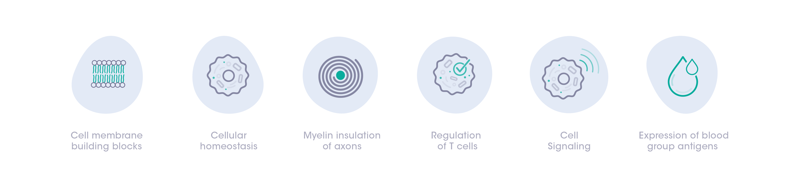
GSLs are important building blocks of cell membranes and fulfill diverse functions^{1,2}
GSLs are vital to maintaining cellular homeostasis and contribute to physiological processes such as cell signaling and regulation of inflammation¹⁻⁴
GSL functions include^{1,2,4}:
1. Aerts JMFG et al. Curr Opin Chem Biol. 2019;53:204-215; 2. Ryckman AE et al. Int J Mol Sci. 2020;21(18):E6881; 3. Shayman JA. Semin Nephrol. 2018;38(2):183-192;
4. van Eijk M et al. Essays Biochem. 2020;64(3):565-578.
MAT-US-2306240 v1.0 – P
Expiration Date: 08/14/2025
For use by Sanofi Medical Affairs for scientific and medical discussions only. Do not photograph, copy or distribute.
Notes:
GSLs are not only important building blocks of cell membranes, they also fulfill diverse functions
GSLs are vital to maintaining cellular homeostasis (a state of balance needed for the body to survive and function correctly) and contribute to physiologic processes, such as cell signaling and regulation of inflammation
The functions of GSLs include:
Cell membrane building blocks
Cellular homeostasis
Myelin insulation of axons
Regulation of T cells
Cell signaling
Expression of blood group antigens

Slide 6
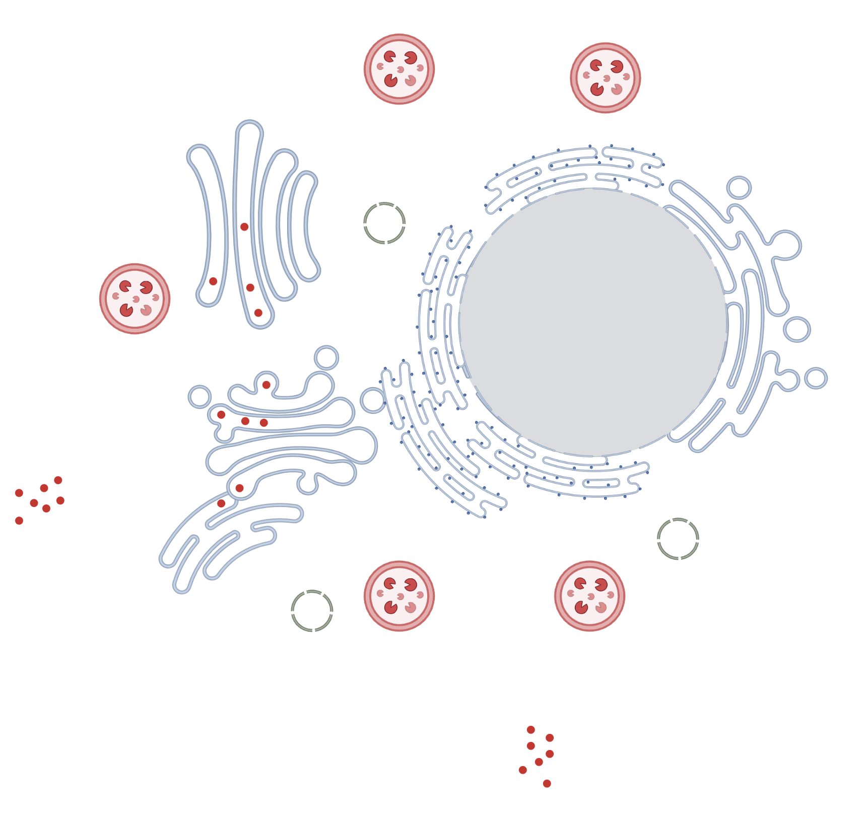
Tight regulation between synthesis, catabolism, and intracellular tracking of GSLs is necessary¹⁻⁴
GSL synthesis occurs in the endoplasmic reticulum and Golgi apparatus of cells, and catabolism happens in lysosomes¹⁻³
As GSLs serve many critical functions for cells, the balance of synthesis and catabolism needs to be preserved⁴
Cell Membrane
Golgi Apparatus
Exocytosis
Endoplasmic Reticulum
GSL
Endocytosis
1. Lannert H et al. J Biolog Chem. 1998; 273(5):2939-2946; 2. Breiden B, Sandhoff K. Annu Rev Biochem. 2019;88:461-485; 3. Grassi S et al. J Neurochem. 2019;148(5):600-611;
4. Ryckman AE et al. Int J Mol Sci. 2020;21(18):E6881.
For use by Sanofi Medical Affairs for scientific and medical discussions only. Do not photograph, copy or distribute.
MAT-US-2306240 v1.0 – P
Expiration Date: 08/14/2025
Notes:
To maintain cellular homeostasis, tight regulation between synthesis, catabolism, and intracellular tracking of GSLs is necessary
GSL synthesis occurs in the endoplasmic reticulum and Golgi apparatus of cells, and catabolism happens in lysosomes
Specific enzymes in these cellular structures drive synthesis and catabolism
Given GSLs serve many critical functions for cells, the balance of their synthesis and catabolism needs to stay intact

Slide 7
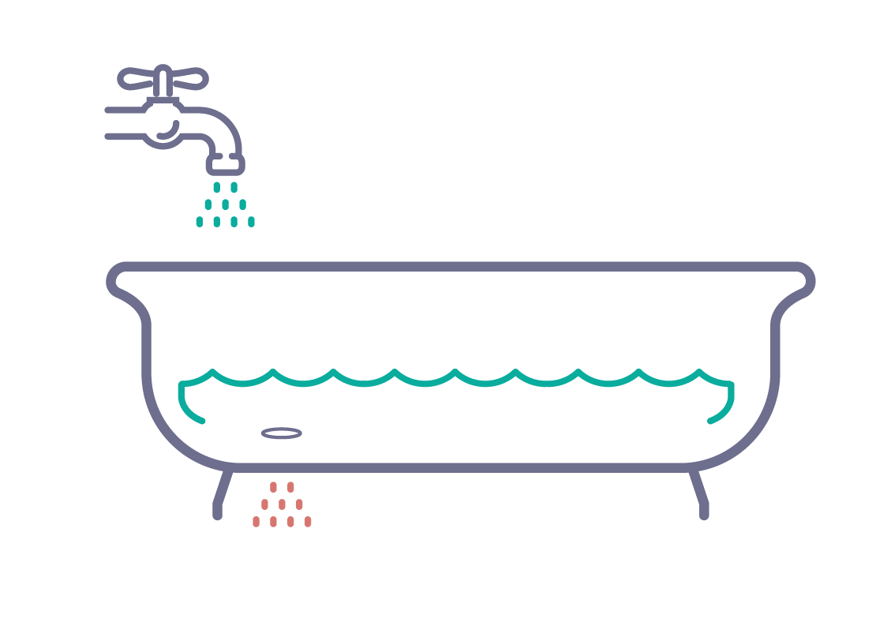
The synthesis and catabolism of GSLs is balanced in healthy individuals¹
Healthy individuals
Synthesis
GSL
Catabolism
1. Ryckman AE et al. Int J Mol Sci. 2020;21(18):E6881.
MAT-US-2306240 v1.0 – P
Expiration Date: 08/14/2025
For use by Sanofi Medical Affairs for scientific and medical discussions only. Do not photograph, copy or distribute.
Notes:
Let’s take a closer look at that balance
In healthy individuals, there is a balance between GSL synthesis and catabolism

Slide 8
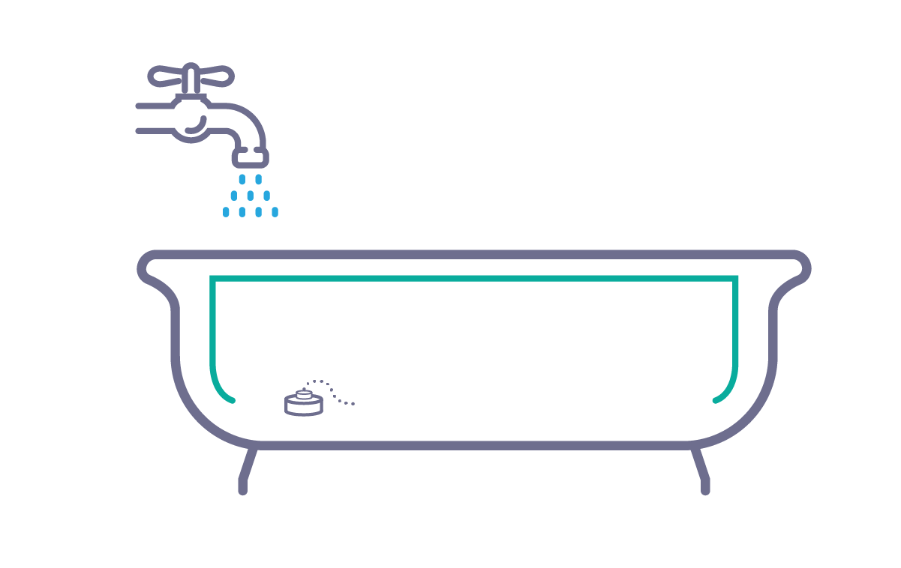
In LSDs, the lysosomal enzymes responsible for the catabolism of GSLs are impaired^{1,2}
Healthy individuals
Patients with LSDs
Synthesis
Synthesis
GSL
GSL
Catabolism
Deficient catabolism
For use by Sanofi Medical Affairs for scientific and medical discussions only. Do not photograph, copy or distribute.
MAT-US-2306240 v1.0 – P
Expiration Date: 08/14/2025
1. Ryckman AE et al. Int J Mol Sci. 2020;21(18):E6881; 2. Aerts JMFG et al. Curr Opin Chem Biol. 2019;53:204-215.
Notes:
In people with LSDs, the lysosomal enzymes responsible for the catabolism of unused or excess GSLs are impaired, such that there is more synthesis than catabolism
This imbalance, due to deficient lysosomal enzyme catabolism, leads to GSL accumulation in cells

Slide 9
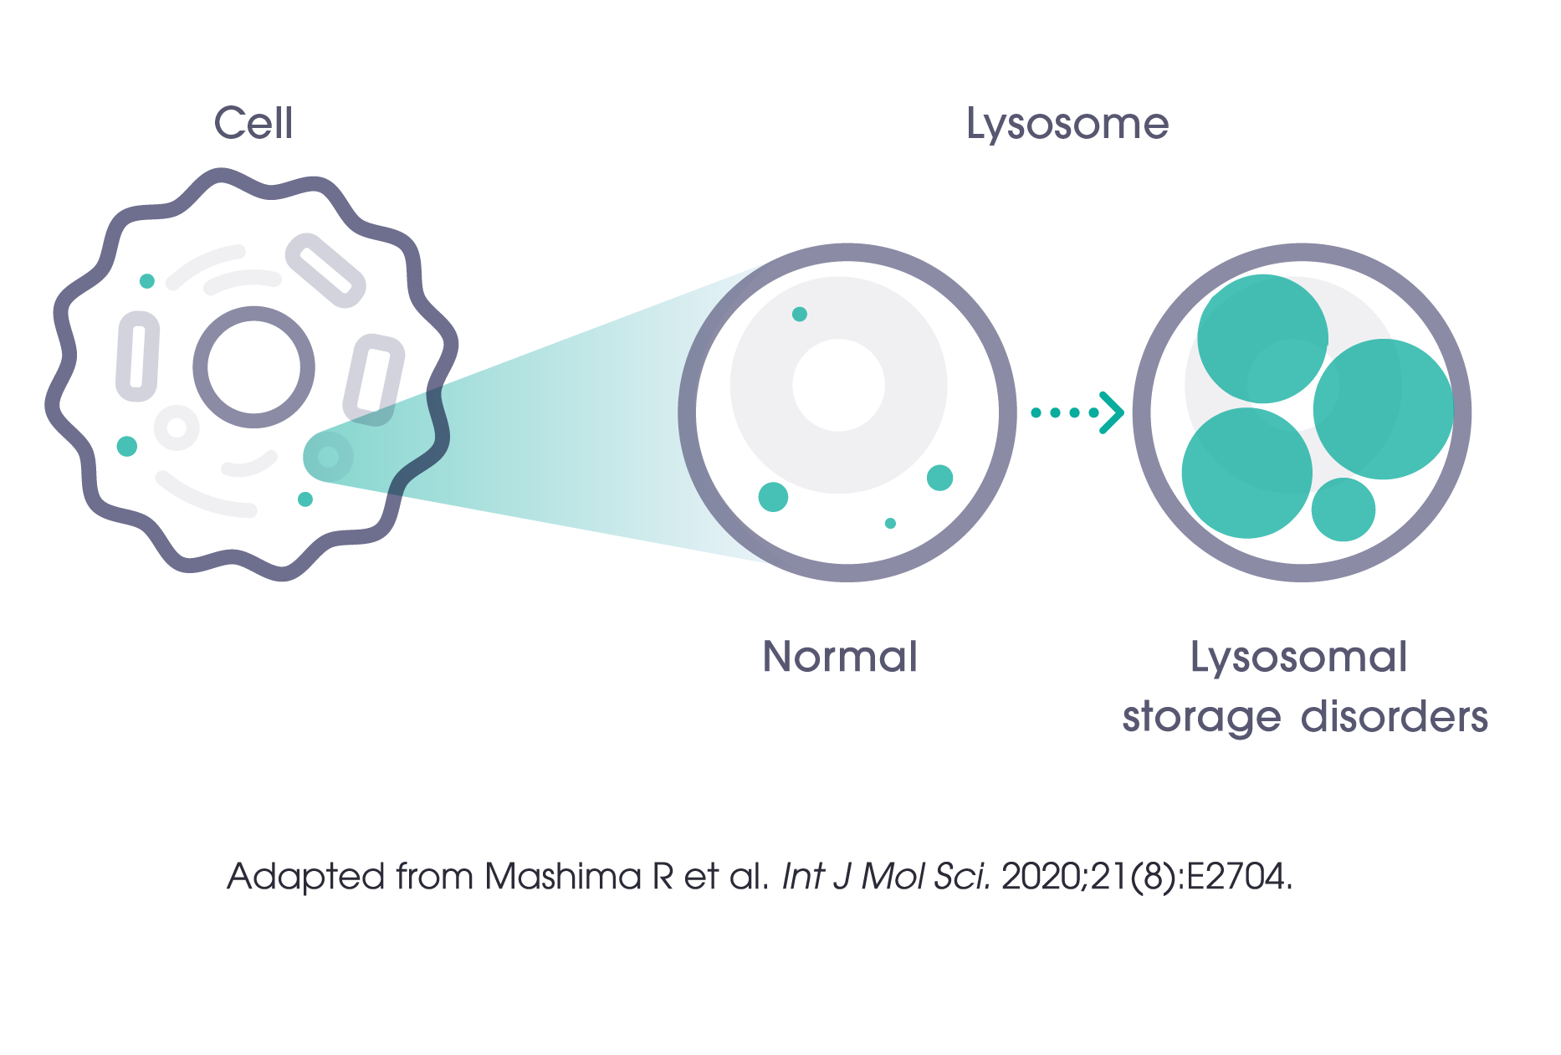
The resulting progressive pathologic accumulation of GSLs in lysosomes is the hallmark of LSDs^{1,2}
Inherited genetic defects compromise the lysosomal enzymes responsible for the catabolism of GSLs¹
The affected cells become functionally impaired or destroyed, which can lead to toxic effects in different organs³
1. Aerts JMFG et al. Curr Opin Chem Biol. 2019;53:204-215; 2. Dodge JC. Front Mol Neurosci. 2017;10:356; 3. Schulze H et al. Cold Spring Harb Perspect Biol. 2011;3(6):a004804;
4. Mashima R et al. Int J Mol Sci. 2020;21(8):E2704.
MAT-US-2306240 v1.0 – P
Expiration Date: 08/14/2025
For use by Sanofi Medical Affairs for scientific and medical discussions only. Do not photograph, copy or distribute.
Notes:
In people with LSDs, inherited genetic defects are what compromise the lysosomal enzymes responsible for the catabolism of GSLs
The result is relentless and pathologic accumulation of GSLs in cells
The affected cells become functionally impaired or destroyed, leading to toxic effects in different organs
The image on the slide illustrates the difference between a normal cell and one in which GSLs have accumulated due to an LSD

Slide 10
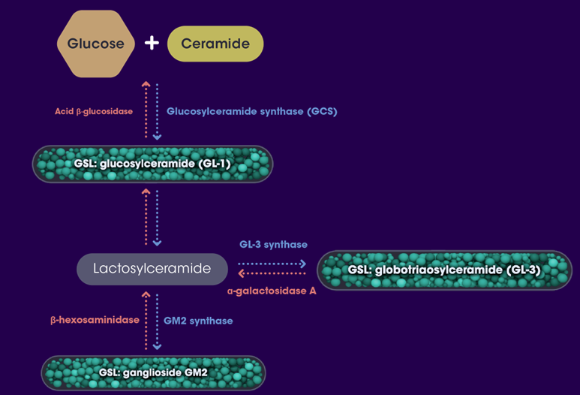
Enzymes synthesize and catabolize GSLs along a metabolic pathway¹⁻³
+
One of the first steps in GSL synthesis is facilitated by an enzyme called glucosylceramide synthase (GCS)
GCS converts glucose and ceramide into glucosylceramide (GL-1)
GL-1 is a key substrate for the biosynthesis of other GSLs
Each type of GSL is catabolized by a specific lysosomal enzyme
Blue = synthesis enzyme
Red = catalytic enzyme
Glucose
Ceramide
Acid β-glucosidase (GBA)
Glucosylceramide synthase (GCS)
GSL: GlcCer (GL-1)
GL-3 synthase
LacCer
GSL: GL-3
α-galactosidase
β-hexosaminidase
GM2 synthase
GSL: GM2
Blue=Production enzyme
Red=Breakdown enzyme
1. Shayman JA. Semin Nephrol. 2018;38(2):183-192; 2. Natoli TA et al. Cell Signal. 2020;69:109526; 3. Schulze H et al. Cold Spring Harb Perspect Biol. 2011;3(6):a004804.
For use by Sanofi Medical Affairs for scientific and medical discussions only. Do not photograph, copy or distribute.
MAT-US-2306240 v1.0 – P
Expiration Date: 08/14/2025
Notes:
Let’s take a closer look at the specific GSL synthesis and breakdown enzymes
These enzymes synthesize and catabolize GSLs along a metabolic pathway
One of the first steps in GSL production is facilitated by an enzyme called glucosylceramide synthase, or GCS
It is GCS that converts glucose and ceramide into a GSL called glucosylceramide, or GL-1
GL-1 is a key substrate for the production of other GSLs
In the image on the slide, you can see 3 different types of GSLs: GL-1, GL-3, and GM2
These GSLs are synthesized by the enzymes GCS, GL-3 synthase, and GM2 synthase, respectively, as noted by blue arrows in the image on the slide
In healthy individuals, these GSLs are catabolized by the lysosomal enzymes acid β-glucosidase (GBA), α-galactosidase A, and β-hexosaminidase, respectively, as noted by red arrows in the image on the slide

Slide 11
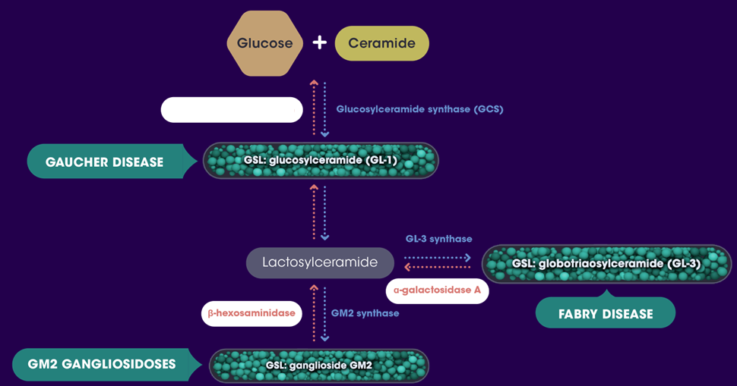
Different GSLs accumulate in the different LSDs due to deficiency of a specific lysosomal catalytic enzyme¹⁻³
+
Glucose
Ceramide
Blue = synthesis enzyme
Red = catalytic enzyme
Red = deficient enzyme
Acid β-glucosidase (GBA)
Glucosylceramide synthase (GCS)
GSL: GlcCer (GL-1)
GL-3 synthase
LacCer
GSL: GL-3
α-galactosidase
β-hexosaminidase
GM2 synthase
Fabry disease
GSL: GM2
1. Shayman JA. Semin Nephrol. 2018;38(2):183-192; 2. Natoli TA et al. Cell Signal. 2020;69:109526; 3. Schulze H et al. Cold Spring Harb Perspect Biol. 2011;3(6):a004804.
MAT-US-2306240 v1.0 – P
Expiration Date: 08/14/2025
For use by Sanofi Medical Affairs for scientific and medical discussions only. Do not photograph, copy or distribute.
Notes:
In LSDs, there is a deficiency in the amount or function of specific lysosomal catabolism enzymes
o This deficiency leads to the accumulation of GSLs in cells, as we discussed earlier
In GM2 gangliosidoses, there is a deficiency of the enzyme β-hexosaminidase, leading to an accumulation of the GSL GM2
In Fabry disease, there is a deficiency of the enzyme α-galactosidase A, leading to an accumulation of the GSL GL-3
In Gaucher disease, there is a deficiency of the enzyme acid β-glucosidase, leading to an accumulation of the GSL GL-1
Let’s take a closer look at each of the LSDs

Slide 12
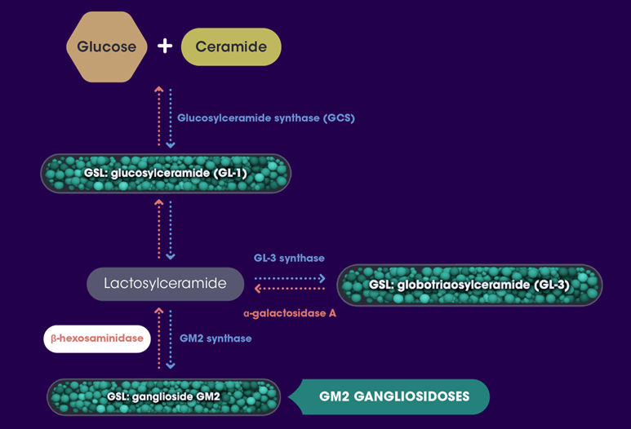

GM2 accumulates in GM2 gangliosidoses¹⁻³
+
Glucose
Ceramide
GM2 gangliosidoses represents
two rare inherited, autosomal recessive, progressive neurodegenerative LSDs that occur due to pathogenic variants in the HEXA or HEXB genes
The genetic variants lead to a deficiency in the enzyme β-hexosaminidase A
(Tay-Sachs disease) or a combined deficiency of β-hexosaminidase A and B (Sandhoff disease)
Deficient β-hexosaminidase (catalytic enzyme) results in GM2 accumulation
Blue = synthesis enzyme
Red = catalytic enzyme
Red = deficient enzyme
Glucosylceramide synthase (GCS)
GSL: GlcCer (GL-1)
LacCer
GSL: GL-3
β-hexosaminidase
GM2 synthase
GSL: GM2
GM2 gangliosidoses
1. Mahuran DJ. Biochim Biophys Acta. 1999;1455(2-3):105-138; 2. Bisel B et al. Biomol Concepts. 2014;5(1):87-93; 3. Toro C et al. Neuroscience Letters. 2021;764:136195.
MAT-US-2306240 v1.0 – P
Expiration Date: 08/14/2025
For use by Sanofi Medical Affairs for scientific and medical discussions only. Do not photograph, copy or distribute.
Notes:
GM2 gangliosidoses represents 2 rare inherited, autosomal recessive, progressive neurodegenerative LSDs that occur due to pathogenic variants in the HEXA or HEXB genes
The genetic variants lead to a deficiency in the enzyme β-hexosaminidase A
(Tay-Sachs disease) or a combined deficiency of β-hexosaminidase A and B (Sandhoff disease)
Deficient β-hexosaminidase (catabolism enzyme) results in GM2 accumulation

Slide 13
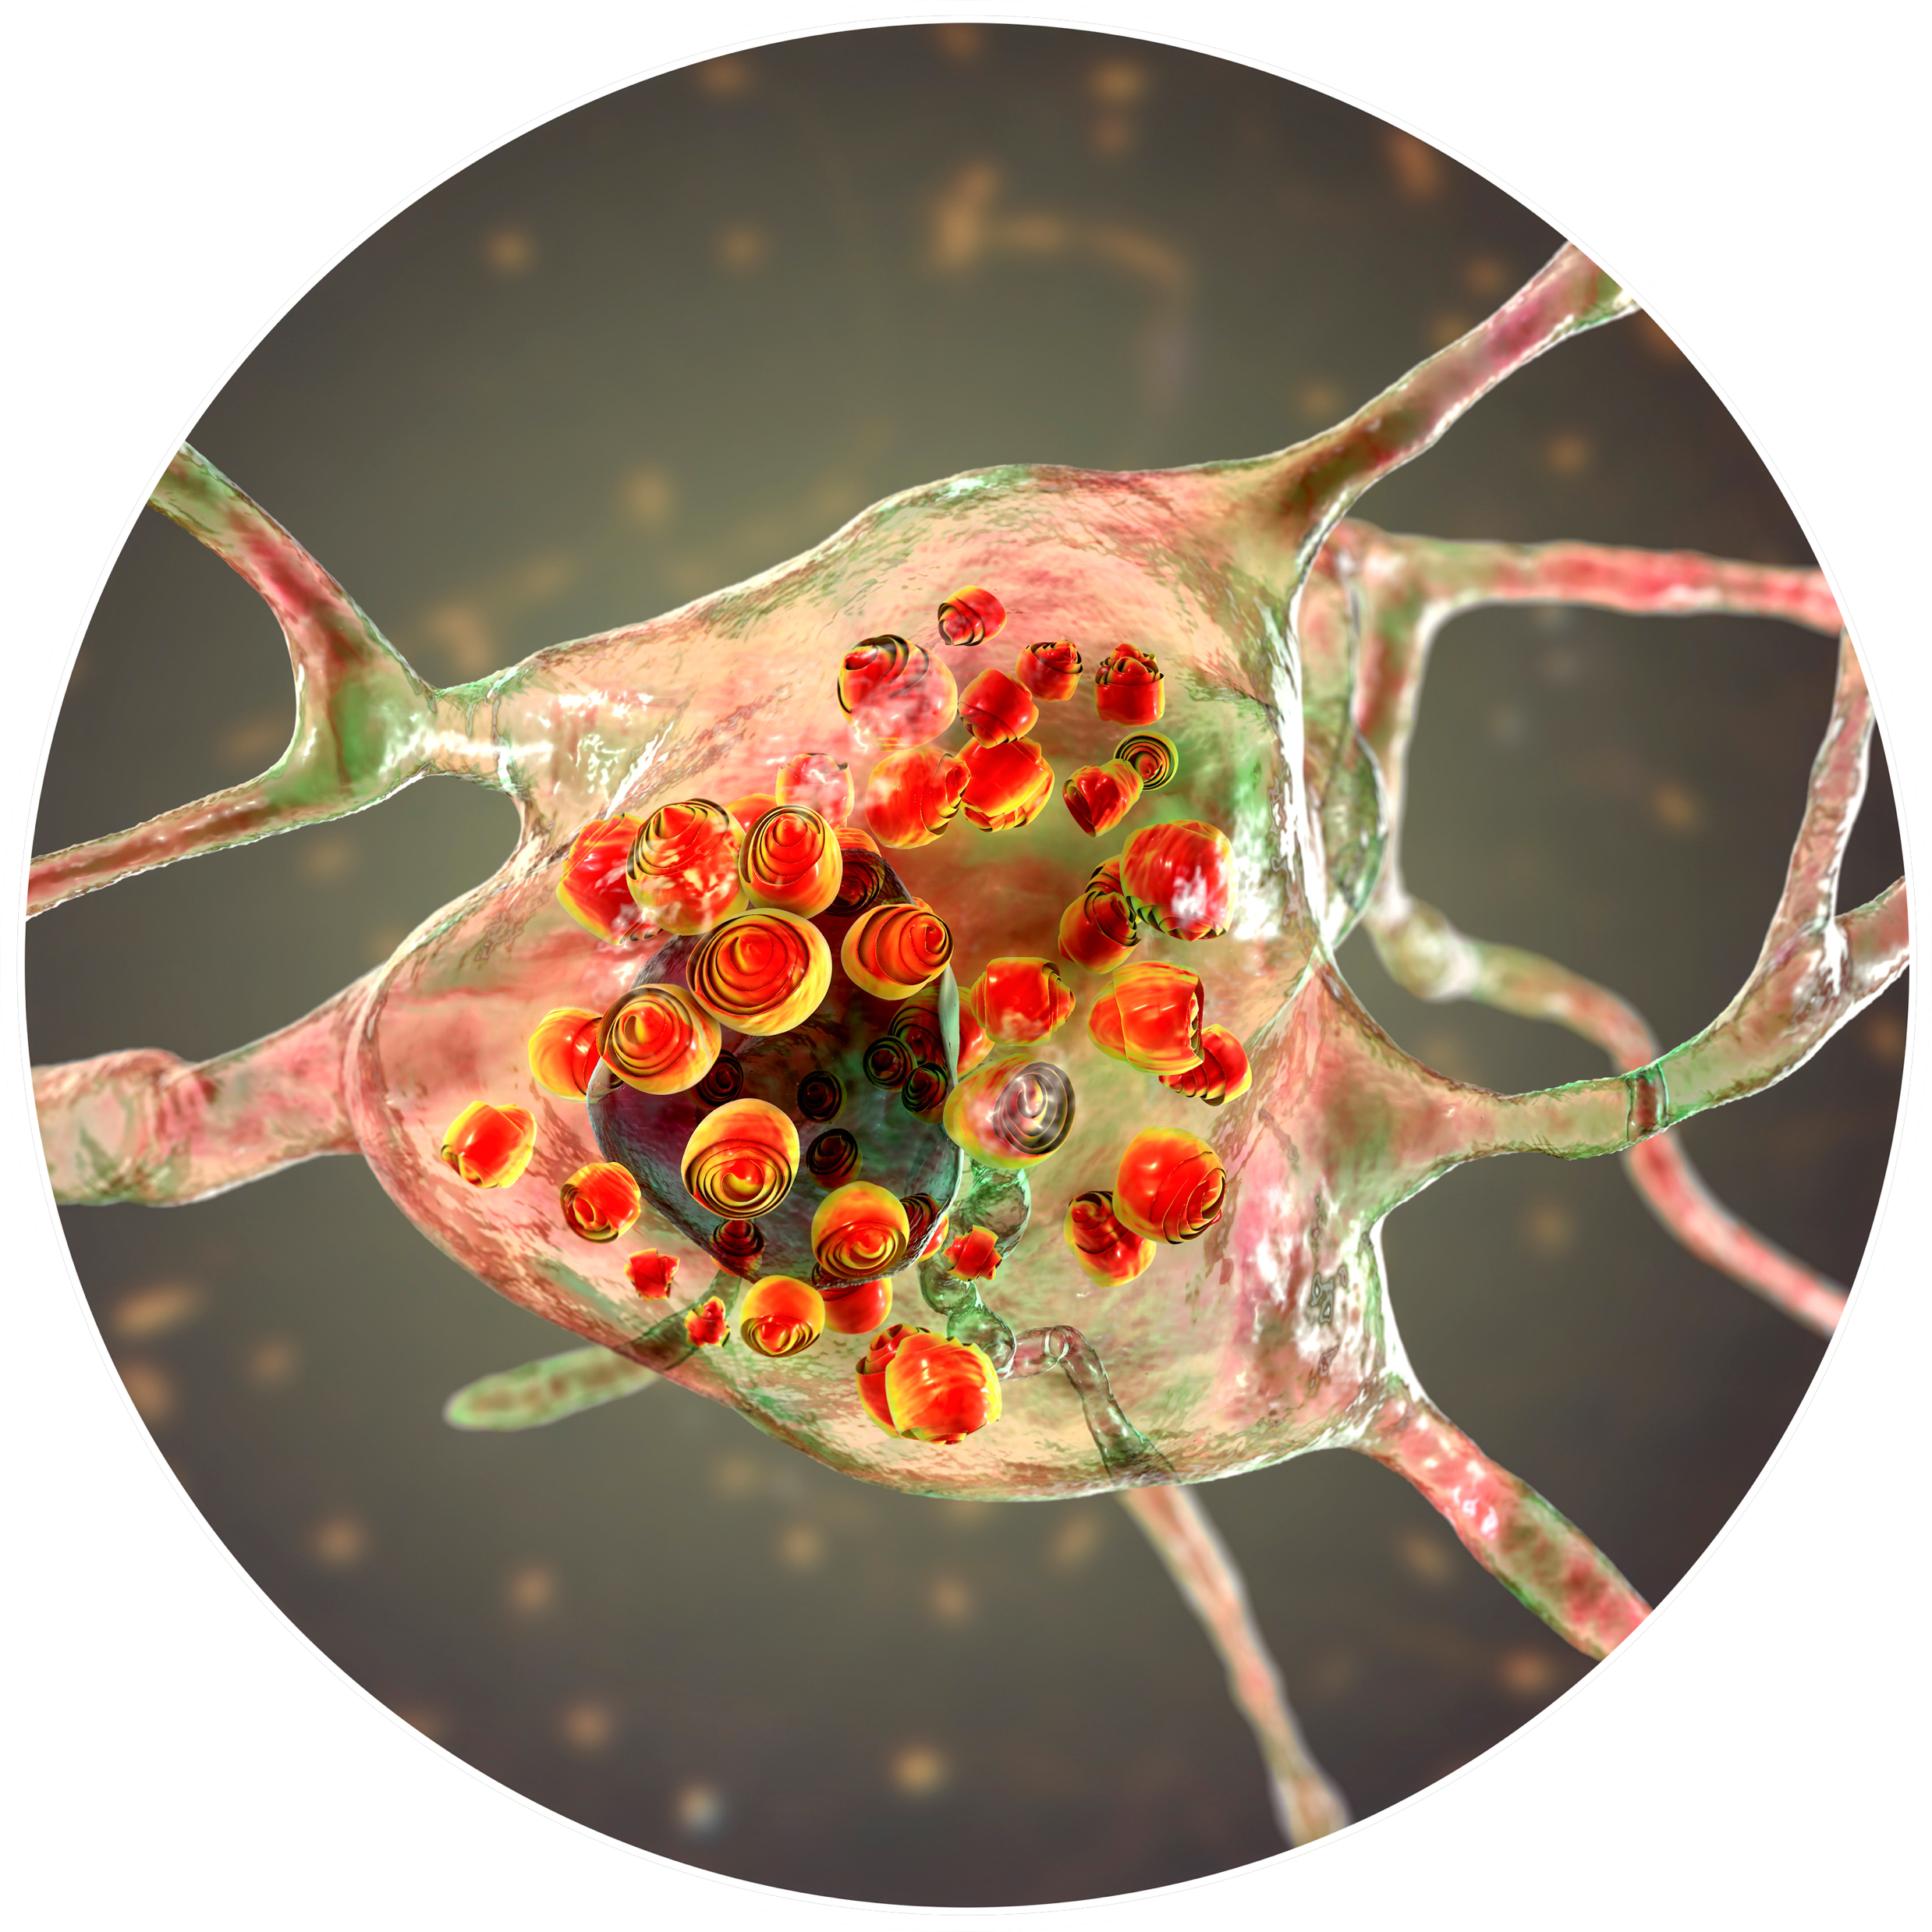
GM2 accumulates in GM2 gangliosidoses¹ (cont’d)
Accumulation of GM2 occurs primarily within neurons and progressively destroys nerve cells in the brain and spinal cord
This accumulation can lead to neurodegenerative symptoms
Swollen neurons with lamellar inclusions, neuronal degradation
With permission from Getty images.
1. Toro C et al. Neuroscience Letters. 2021;764:136195.
MAT-US-2306240 v1.0 – P
Expiration Date: 08/14/2025
For use by Sanofi Medical Affairs for scientific and medical discussions only. Do not photograph, copy or distribute.
Notes:
In GM2 gangliosidoses, accumulation of GM2 occurs primarily within neurons and progressively destroys nerve cells in the brain and spinal cord
The image on the slide illustrates swollen neurons and neuronal degradation due to GM2 accumulation
This accumulation leads to neurodegenerative symptoms

Slide 14
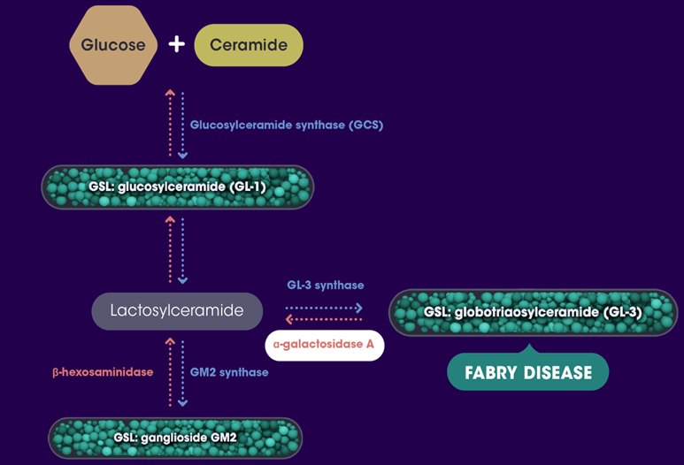
GL-3 accumulates in Fabry disease^{1,2}
Fabry disease is a rare, progressive,
X-linked LSD resulting from a deficiency
in the α-galactosidase A enzyme
Deficient α-galactosidase A (catalytic enzyme) results in GL-3 accumulation
Blue = synthesis enzyme
Red = catalytic enzyme
Red = deficient enzyme
1. Germain DP. Orphanet J Rare Dis. 2010;5:30;
2. Desnick RJ, et al. In: Valle DL, Antonarakis S, Ballabio A, eds. The Online Metabolic and Molecular Bases of Inherited Disease. McGraw Hill; 2020.
MAT-US-2306240 v1.0 – P
Expiration Date: 08/14/2025
For use by Sanofi Medical Affairs for scientific and medical discussions only. Do not photograph, copy or distribute.
Notes:
Fabry disease is a rare, progressive, X-linked LSD resulting from a deficiency in the α-galactosidase A enzyme
Deficient α-galactosidase A (catabolism enzyme) results in GL-3 accumulation

Slide 15
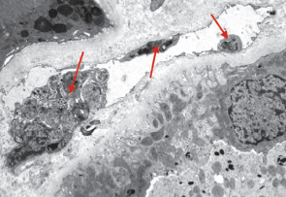
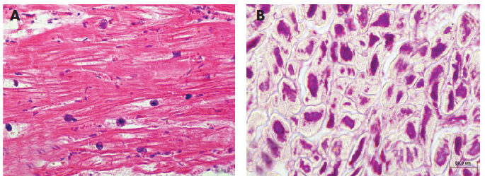
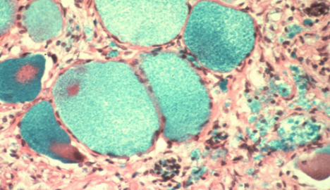
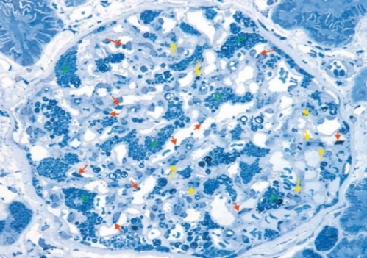
GL-3 accumulates in Fabry disease¹⁻³ (cont’d)
Accumulation of GL-3 occurs in different cell types of the heart, kidneys, and cerebrovascular system, which can lead to significant and progressive organ damage
Nerve damage which can lead to acute and chronic pain and autonomic dysfunction, impacting the gastrointestinal system (enteric neuropathy)
Vascular endothelial cells
Cardiomyocytes
Dorsal root ganglion cells
Kidney cells
With permission from Thurberg BL, et al. Kidney Int. 2002;62(6):1933-1946.
With permission from Linhart A, Elliot PM, et al. Heart. 2007;93(4):528-535.
Courtesy of E. Kaye.
1. Germain DP. Orphanet J Rare Dis. 2010;5:30; 2. Desnick RJ et al. In: Valle DL, Antonarakis S, Ballabio A, eds. The Online Metabolic and Molecular Bases of Inherited Disease. McGraw Hill; 2020; 3. Ortiz A et al. Mol Genet Metab. 2018;123(4):416-427.
MAT-US-2306240 v1.0 – P
Expiration Date: 08/14/2025
For use by Sanofi Medical Affairs for scientific and medical discussions only. Do not photograph, copy or distribute.
Notes:
In Fabry disease, accumulation of GL-3 occurs in different cell types of the heart, kidneys, and cerebrovascular system, leading to significant and progressive organ damage
Nerve damage leads to acute and chronic pain and autonomic dysfunction, impacting the gastrointestinal system (enteric neuropathy)
The images on the slide illustrate GL-3 accumulation in vascular endothelial cells, cardiomyocytes, dorsal root ganglion cells, and kidney cells

Slide 16
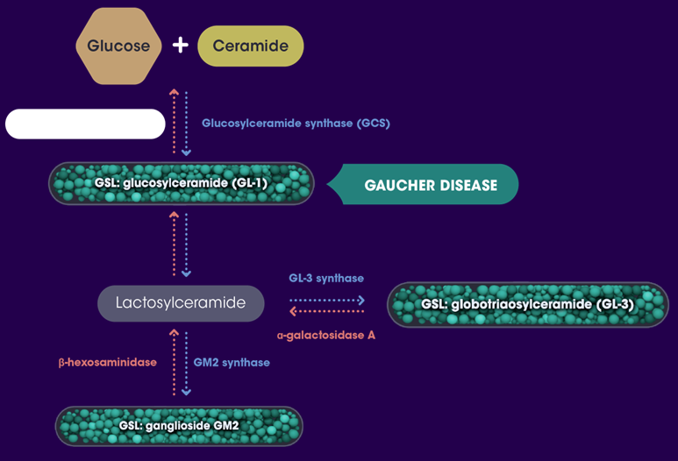
GL-1 accumulates in Gaucher disease^{1,2}
+
Glucose
Ceramide
Gaucher disease is a rare, autosomal recessive LSD caused by pathogenic variants in the glucocerebrosidase (GBA1) gene
Resulting deficiency of the catabolism enzyme acid β-glucosidase which can lead to accumulation of the GSL glucosylceramide (GL-1) in the lysosomes of macrophages known as Gaucher cells
Blue = synthesis enzyme
Red = catalytic enzyme
Red = deficient enzyme
Acid β-glucosidase (GBA)
Glucosylceramide synthase (GCS)
Gaucher disease
GSL: GlcCer (GL-1)
LacCer
GSL: GL-3
GSL: GM2
1. Pastores GM et al. Semin Hematol. 2004;41(4 suppl 5):4-14; 2. Cox TM. J Inherit Metab Dis. 2001;24(suppl 2):106-121.
MAT-US-2306240 v1.0 – P
Expiration Date: 08/14/2025
For use by Sanofi Medical Affairs for scientific and medical discussions only. Do not photograph, copy or distribute.
Notes:
Gaucher disease is a rare, autosomal recessive LSD caused by pathogenic variants in the GBA gene
Resulting deficiency of the catabolism enzyme acid β-glucosidase leads to accumulation of the GSL glucosylceramide (GL-1) in the lysosomes of macrophages known as Gaucher cells

Slide 17
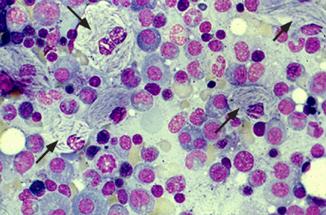
GL-1 accumulates in Gaucher disease¹⁻⁴ (cont’d)
In Gaucher disease, accumulation of GL-1 occurs in the cells of the liver, spleen, bone marrow, and brain, which can result in progressive multiorgan dysfunction
Gaucher disease is classified into 3 types
  Type 1 is the most common and has hematologic, visceral, and skeletal manifestations
  Types 2 and 3 have neurologic manifestations
    Type 2 has overwhelming central nervous system (CNS) involvement and typically results in infancy fatality
    Type 3 has slower progression of neuronopathic manifestation
Gaucher cells in bone marrow
Image courtesy of David S. Rosenthal, MD and William C. Moloney, MD.
1. Pastores GM et al. Semin Hematol. 2004;41(4 suppl 5):4-14; 2. Cox TM. J Inherit Metab Dis. 2001;24(suppl 2):106-121; 3. Schiffmann R et al. J Inherit Metab Dis. 2020;43(5):1056-1059; 4. Roshan Lal T et al. Diseases. 2017;5(1):E10.
MAT-US-2306240 v1.0 – P
Expiration Date: 08/14/2025
For use by Sanofi Medical Affairs for scientific and medical discussions only. Do not photograph, copy or distribute.
Notes:
In Gaucher disease, accumulation of GL-1 occurs in the cells of the liver, spleen, bone marrow, and brain, resulting in progressive multiorgan dysfunction
The image on the slide shows GL-1 accumulation in the marrow
Gaucher disease is classified into 3 types
Type 1 is the most common and has hematologic, visceral, and skeletal manifestations due to GL-1 accumulation
Types 2 and 3 have neurologic manifestations
Type 2 has overwhelming CNS involvement and results in infancy fatality
Type 3 has slower progression of neuronopathic manifestations

Slide 18
Summary¹⁻³
  Inherited genetic defects impair the lysosomal enzymes responsible for catabolizing GSLs
The progressive pathologic accumulation of undegraded GSLs in lysosomes and other cells is the hallmark of some LSDs
  GSL accumulation continues, which can cause multiorgan damage and dysfunction
1. Aerts JMFG et al. Curr Opin Chem Biol. 2019;53:204-215; 2. Dodge JC. Front Mol Neurosci. 2017;10:356; 3. Schulze H et al. Cold Spring Harb Perspect Biol. 2011;3(6):a004804
MAT-US-2306240 v1.0 – P
Expiration Date: 08/14/2025
For use by Sanofi Medical Affairs for scientific and medical discussions only. Do not photograph, copy or distribute.
Notes:
In summary
Inherited genetic defects impair the lysosomal enzymes responsible for catabolizing GSLs
The progressive and relentless pathologic accumulation of undegraded GSLs in lysosomes and other cells is the hallmark of some LSDs
If these LSDs are left untreated, GSL accumulation continues, causing multiorgan damage and dysfunction
Venglustat is an investigational oral SRT that inhibits GCS to reduce the synthesis of the GSLs implicated in the pathophysiology of GM2 gangliosidoses, Fabry disease, and Gaucher disease types 1 and 3
Venglustat has the unique ability to reach target tissues due to potency, selectivity, and CNS accessibility

Slide 19
Glossary
CNS: central nervous system; the part of the nervous system which consists of the brain and spinal cord
GBA1 gene: glucocerebrosidase gene; the gene that carries pathogenic variants in Gaucher disease
GCS: glucosylceramide synthase; the enzyme that catalyzes the first step in glycosphingolipid production
GL-1: glucosylceramide; the glycosphingolipid that accumulates in Gaucher disease
GL-3: globotriaosylceramide; the glycosphingolipid that accumulates in Fabry disease
GM2: ganglioside GM2; the glycosphingolipid that accumulates in GM2 gangliosidoses (Tay-Sachs disease, Sandhoff disease)
GSL: glycosphingolipid; a building block of cell membranes
HEXA gene: the gene that codes for the alpha subunit of the β-hexosaminidase A enzyme
HEXB gene: the gene that codes for the beta subunit of the β-hexosaminidase A enzyme
LSD: lysosomal storage disorder; inherited metabolic disorders in which lipids accumulate in cells and tissues
X-linked: of or relating to a trait controlled by a gene or genes on the X chromosome
MAT-US-2306240 v1.0 – P
Expiration Date: 08/14/2025
For use by Sanofi Medical Affairs for scientific and medical discussions only. Do not photograph, copy or distribute.

Slide 20
Thank you
MAT-US-2306240 v1.0 – P
Expiration Date: 08/14/2025
For use by Sanofi Medical Affairs for scientific and medical discussions only. Do not photograph, copy or distribute.
20
Notes:
Additional questions can be discussed at this time.

