Slide 1

Mucopolysaccharidosis I
(MPS I)
©2023 Genzyme Corporation. All rights reserved. Sanofi is a
registered trademark of Sanofi or an affiliate.
Individual with MPS I
Photo permissions on file
MAT-US-2023130 v4.0 – P
Expiration Date: 08/08/2025
For use by Sanofi Medical Affairs for scientific and medical discussions only. Do not photograph, copy or distribute.
1

Slide 2
NOTICE
This program is non-promotional and sponsored by Sanofi.
The content contained in this presentation was developed by Sanofi and is not eligible for continuing medical education (CME) credits.

Slide 3

Mucopolysaccharidosis Type I (MPS I) is a Lysosomal Storage Disorder (LSD)
Lysosomal
Storage Disorders (>50 identified)
Overall Incidence of ~1: 8,000
Mucopolysaccharidoses
(7 types)
Incidence
1:25,000
MPS I
Incidence
1:100,000
Individual with MPS I
Photo permission on file
Meikle, et al. JAMA. 1999;281:249–254; Tomatsu et al. Mol Genet Metab. 2013 ; 110(0): 42–53.

Slide 4




Inheritance of MPS I
  MPS I is inherited in an autosomal
  recessive pattern
  Both males and females have an equal chance of inheriting a pathogenic variant in the IDUA gene
  The majority of diagnosed patients have the most severe form of the disease (i.e. Hurler syndrome)
  Unaffected carrier mother and father
Normal
gene
MPS I mutation
Unaffected
non-carrier child
Unaffected carrier children
Child with
MPS I
Moore D, et al. Orphanet J Rare Dis. 2008;3:24; New South Wales Government Health. Autosomal Recessive Inheritance—traditional patterns of inheritance 1. 2012; Beck M, et al. Genet Med. 2014;16(10):759–765.

Slide 5
Epidemiology of MPS I
  The mucopolysaccharidoses are a group of LSDs caused by deficiency of enzymes that degrade GAGs
  MPS I is a rare LSD that results in widespread and progressive organ dysfunction
    Pan-ethnic
    Prevalence varies in different populations
Estimated worldwide incidence:
1:100,000 births
GAG, glycosaminoglycan; LSD, lysosomal storage disorders.

Slide 6
MPS I Disease Pathophysiology
GAGs are important structural components of cellular membranes, extracellular matrix, connective tissue, and joint fluids. GAGs are also involved in cell division, cell differentiation, and cell-cell communication.
There are five types of GAGs
  Heparan and dermatan sulfate are the two GAGs unable to be degraded in MPS I
Dermatan Sulfate
Cleavage site for alpha-L-iduronidase
H₂COH
COOH
H₂COH
O
S
O
O
O
O
COOH
O
O
O
O
O
S
NA_{C}
NA_{C}

Slide 7
Pathophysiology of MPS I
  Individuals with MPS I have a mutation in the IDUA gene that codes for the production of alpha-L-iduronidase
    Enzyme levels in affected individuals may range from undetectable to <0.1% of normal activity
    The lack of enzymatic activity results in accumulation of GAGs, specifically heparan and dermatan sulfate, within the lysosomes
Normal
lysosome
GAG-filled
lysosome
Neufeld EF, Muenzer J.In: Scriver CR, Beaudet AL, Sly WS, Valle D, eds. The Metabolic & Molecular Bases of Inherited Disease. New York, NY: McGraw-Hill; 2001:3421–3452. Vijay S, Wraith JE. Acta Paediatr. 2005;94(7):872–877.
GAG, glycosaminoglycan; IDUA, α-l-iduronidase.

Slide 8
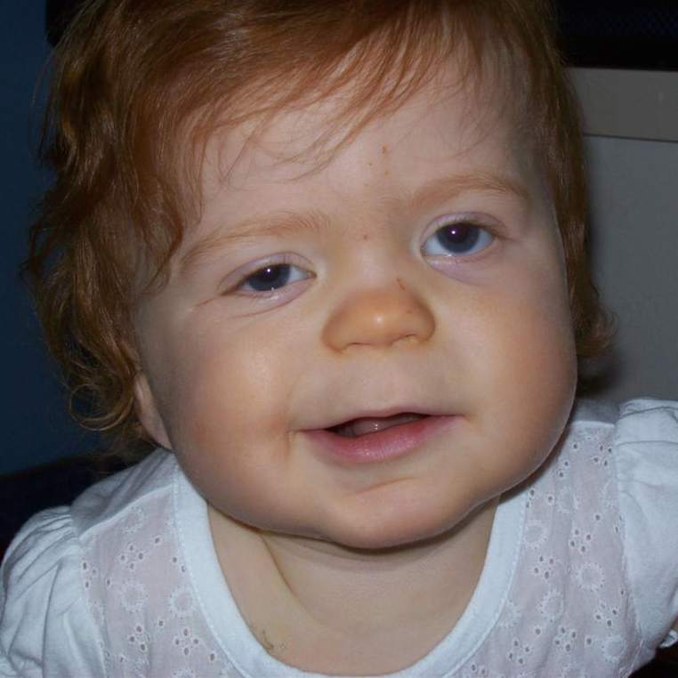
MPS I Spectrum of Disease
Severe
Attenuated
Individuals with MPS I
Photo permissions on file
 | Hurler | Hurler–Scheie | Scheie
Age at diagnosis | 0.2 – 7 years | 0.2 – 36 years | 2 – 54 years
Effect on cognition | Pronounced mental delay with loss of acquired skills | No/mild mental delay; learning disabilities | No impairment
Mean life expectancy (without disease management) | 7 years | Approximately 20 years | Adulthood
Phenotype distribution | ~65% | ~25% | ~10%
Neufeld EF, Muenzer J.. In: David Valle, et al., eds. The Online Metabolic and Molecular Bases of J. IN Inherited Diseases. New York, NY: McGraw-Hill, 2014; OMMBID. https://ommbid.mhmedical.com/content.aspx?bookid=2709&sectionid=225544161. 18 Feb. 2015; Beck, et al. Genet Med. 2014;16(10):759–765

Slide 9


The Clinical Manifestations of Attenuated MPS I are Widespread
Orthopedic | Subtle facial dysmorphisms
 | Short stature
 | Joint and bone deformities
 | Joint contracture
MRI abnormalities | Neurological
No or mild cognitive dysfunction
Communicating hydrocephalus
Carpal tunnel syndrome
Visceral | Airway-related symptoms
 | Cardiac abnormalities
 | Abdominal abnormalities
Ocular | Sensory
Auditory
Individual with MPS I
Photo permission on file
Clinical presentation and organ involvement varies with phenotype
and extent of disease progression
Please note that many symptoms have interlinking etiology so could be placed in multiple categories.
Muenzer J, et al. Pediatrics. 2009;23:19–29.

Slide 10
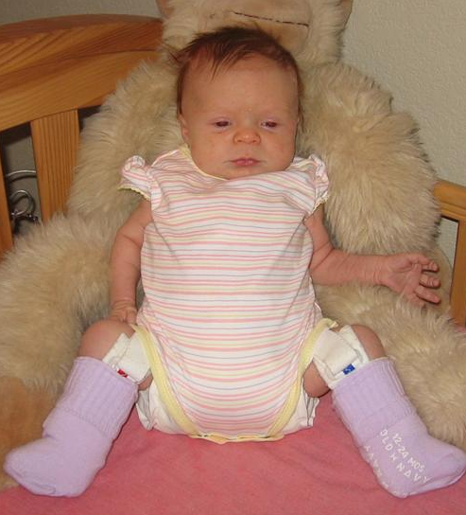

The Clinical Manifestations of Severe MPS I are Widespread
Orthopedic | Early onset facial dysmorphisms
 | Gibbus deformity
 | Joint and bone deformities
 | Dysostosis
MRI abnormalities | Neurological
Cognitive dysfunction
Communicating hydrocephalus
Carpal tunnel syndrome
Ocular | Sensory
Auditory
Visceral | Airway-related symptoms
 | Early cardiac involvement
 | Hepatosplenomegaly
 | Umbilical hernias
Individual with MPS I
Photo permission on file
Clinical presentation and organ involvement including cognitive impairment is apparent within 6 months of age
Please note that many symptoms have interlinking etiology so could be placed in multiple categories. Photo permission on file.
Muenzer J, et al. Pediatrics. 2009;23:19–29.; Clarke LA, et al. J Pediatr. 2017;182:363-370.

Slide 11
Top 5 Presenting Symptoms by Patients in the MPS I Registry
Median age at first symptoms (years)
0
2
4
6
8
10
12
14
Coarse Facial Features (86.4%)
Hernia (58.9%)
HURLER (severe)
Kyphosis (70%)
Hepatomegaly (70%)
Corneal Clouding (70.9%)
Hernia (59.9%)
Coarse Facial Features (72.7%)
HURLER–SCHEIE
(attenuated)
Corneal Clouding (68.3%)
Hepatomegaly (66.5%)
Cardiac Valve Abnormality (59%)
Hernia (53.5%)
Joint Contractures (69.3%)
SCHEIE
(attenuated)
Corneal Clouding (70.1%)
Valve Abnormalities (67.7%)
Carpal Tunnel (51.2%)
Corneal clouding and hernias are present across the spectrum of diseases
Beck M, et al. Genet Med 2014;16:759–765

Slide 12
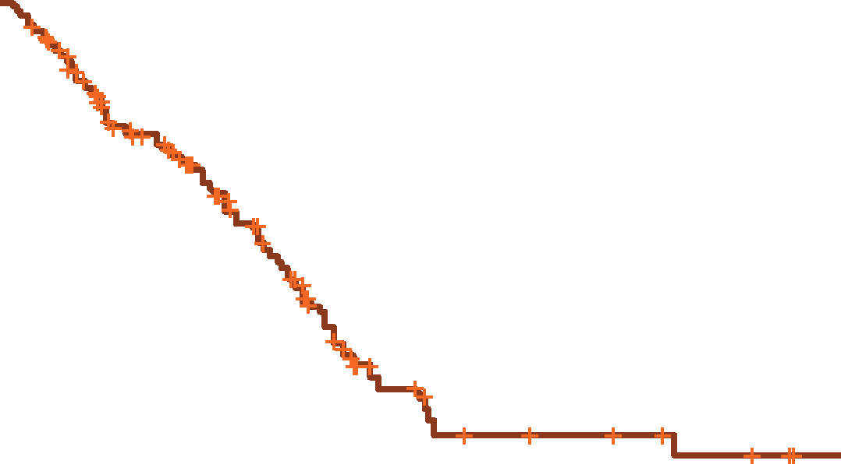
Life Expectancy
Patients with MPS I experience severe morbidities that can decrease life expectancy
1
0.9
Hurler-Scheie*
0.8
0.7
0.6
0.5
Surviving Proportion
0.4
0.3
0.2
Hurler*
Kaplan Meier Survival Curve
0.1
*Without disease-specific intervention
0
0
5
10
15
20
25
Years
Adapted with permission from Moore D, et al. Orphanet J Rare Dis 2008;3:24. © 2008 Moore et al; licensee BioMed Central Ltd.
Moore D, et al. Orphanet J Rare Dis. 2008;3:24; Beck M, et al. Genet Med. 2014;16(10):759-765; Neufeld EF, Muenzer J. The mucopolysaccharidoses. In: Scriver CR, Beaudet AL, Sly WS, Valle D, eds. The Metabolic & Molecular Bases of Inherited Disease. New York, NY: McGraw-Hill; 2001:3421-3452.
Notes:
Patients with Hurler syndrome have the shortest life expectancy (less than 10 years), whereas patients with Scheie syndrome usually survive to middle age with and without disease management
Cardiovascular complications and restricted airway disease are the leading morbidities associated with early deaths in patients with MPS I

Slide 13
Management Involves a Multidisciplinary Approach
Occupational
Therapy
Physical
Therapy
  Early diagnosis and management by multidisciplinary team may improve outcomes in MPS I^{1,2}
Neurologist
Pulmonologist
Orthopedist
Respiratory
Therapy
Psychosocial
Therapy
Patient
Cardiologist
Primary
Care
Physician
Geneticist/
Metabolic
Specialist
Endocrinologist
Genetic
Counseling
Speech
Therapy
Nutritional
& Diet
Therapy
1. Martins AM, et al. J Pediatrics. 2009;155:S32–S46; 2. Muenzer J, et al. Pediatrics. 2009;123:19–29; 2
Illustration based on Kishnani, et al. Genet Med. 2006;8:267–288.
Notes:
Also, potentially Anesthesia and Transplantation ²

Slide 14

Cardiac manifestations are a major source of morbidity and mortality¹
  Cardiac valve disease is common in MPS I due to GAG accumulation causing thickening and loss of elasticity^{1–4}
    Mitral and aortic valve thickening^{1,3,4}
    Cardiac valve abnormalities in up to 90% of patients³
  Aortic insufficiency is more common than stenosis in patients with MPS^{1, 4}
    Mild-to-moderate forms can be present without significant murmurs
    May lead to left atrial and/or left ventricular abnormalities, resulting in systolic and diastolic dysfunction
      Both aortic insufficiency and stenosis can result in this pathology
  Cardiomyopathy
    Dilated or hypertrophic; can be present in early infancy in patients with severe MPS I⁵
Autopsy specimen from a girl with MPS I-Hurler who died at age 2.8 years. (a) Dysplastic and thickened mitral valve with a thickened subvalvar apparatus and parietal LVH. (b) Dysplastic aortic valve
GAG, glycosaminoglycan.
1. Braunlin EA, et al. J Inherit Metab Dis. 2011;34:1183–1197; 2. Nemes A, et al. Heart Vessels 2008;23:108–111; 3. Thomas JA, et al. J Inherit Metab Dis 2010;33:421–427;
4. Fesslová V, et al. Cardiol Young. 2009;19:170–178; Pillai NR, et al. Genes (Basel).2022 13(8):1293

Slide 15

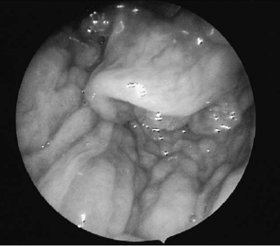
Airway-Related Symptoms are Often the Earliest Signs of Attenuated MPS I
  Airway-related symptoms often precede diagnosis by several years in patients
  with MPS I¹
  Recurrent ear, nose, and throat infections¹
  Airway obstruction causes¹:
    Enlarged tonsils
    Enlarged tongue
    Restricted mouth opening
    Tracheobronchomalacia (softening/damage of tracheal and bronchial cartilage)
    Mucosal swelling
    Sleep disturbances
      “Noisy breathing,” snoring, sleep apnea¹
  MPS I deposits obstructing the
  pharynx and larynx
From Simmons MA, et al. 2005³
1. Arn P, et al. Ann Otol Rhinol Laryngol. 2015;124:198–205; 2. Pal AR, et al. Orphanet J Rare Dis. 2015;10:42; 3. Simmons MA, et al. Int J Pediatr Otolarygol. 2005;69:589–595.

Slide 16

Spinal Cord Compression in MPS I
  Thickening of the dura (pachymeningitis cervicalis) leads to compression of the
  cervical cord
  Spondylolisthesis of the lower spine commonly leads to spinal compression in patients with attenuated MPS I
  Spinal cord compression can result in myelopathy and neurological symptoms such as weakness, gait abnormalities, paraparesis, pyramidal signs (e.g. hyperactive deep tendon reflexes), abnormalities in sensation, bowel/bladder dysfunction, apnea, and can lead to sudden death
  Spinal cord compression in a
  14-year-old patient
Patient with MPS I; Courtesy of
Dr N. Guffon
Alden TD et al. Mol Genet Metab. 2017;122S:41-48

Slide 17

Skeletal Manifestations
Manifestations
  In severe MPS I, skeletal involvement may not be evident until the characteristic gibbus deformity of the lumbar spine is apparent at 6 to 14 months of age
  Kyphosis and/or scoliosis are common presenting symptoms in attenuated MPS I, accompanied by
  hip and back pain
  Patients present with mild to severe skeletal involvement and tend to have short stature.
  Teeth deformities are also possible in MPS I patients
Management
  Patients with moderate/severe skeletal disease should be monitored by an orthopedic surgeon
  Physical and occupational therapy can improve functional independence and quality of life
Muenzer J, et al. Pediatrics. 2009;123:19–29.
Notes:
Added bullet about dentition

Slide 18
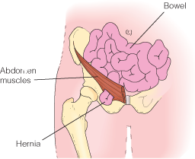

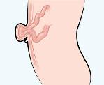
GAG Build Up Causes Organomegaly and Hernias in MPS I
  Organomegaly due to GAG build up causing:
  Abdominal protrusion¹
  Restricted lung expansion¹
  Increased intra-abdominal pressure
  Organomegaly occurs more frequently in attenuated patients, historically classified as Hurler–Scheie patients, compared with Scheie patients
  Hernias are reported in up to 60% of patients²
  Umbilical hernias are more common
  than inguinal hernias³
  Gastrointestinal symptoms include:
  Constipation
  Diarrhea
  Abdominal pain
  Inguinal hernias
Patient with MPS I; Courtesy of Dr. F. Wijburg
Umbilical hernia
GAG, glycosaminoglycan.
1. Muenzer J, et al. Pediatrics. 2009;123:19–29; 2. Beck M, et al. Genet Med. 2014;16:759–765; 3. Thomas JA, et al. J Inherit Metab Dis. 2010;33:421–427.

Slide 19

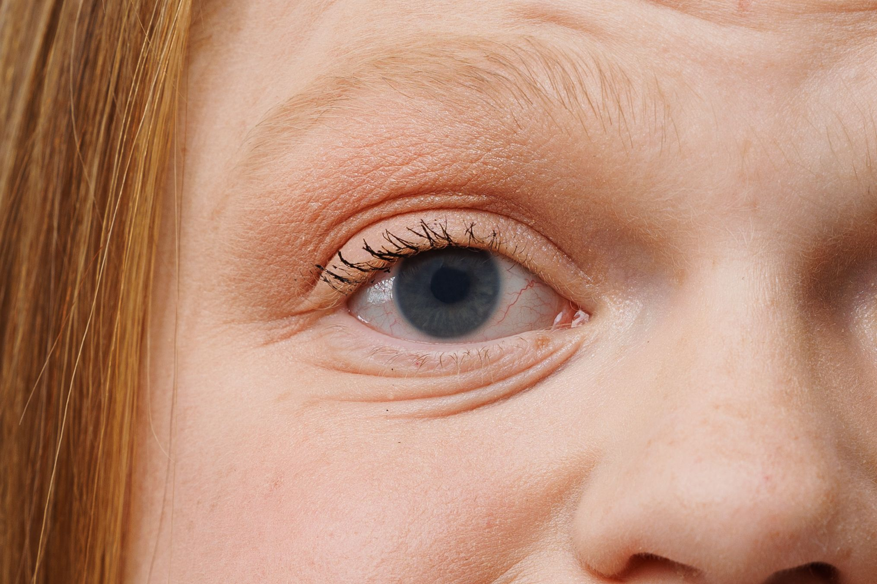
Ophthalmological Symptoms May Affect Development and
Quality of Life
  Unilateral or bilateral corneal clouding¹
    ~70–80% will have some degree of corneal clouding^{2–4}
    Highly prevalent and relatively early manifestation^{1,5}
  Decreased visual acuity⁴
  Optic nerve swelling/atrophy⁶
  Glaucoma⁵
  Retinopathy^{4,5}
  Optic disc swelling less common in attenuated MPS I^{4,6}
Corneal clouding in individual with severe MPS I
Photo permission on file
Eye examinations, including acuity and pressure assessments and ophthalmoscopy, should be performed at diagnosis and annually thereafter⁵
1. Cimaz R, et al. Clin Exp Rheumatol. 2006;24:196–202; 2. Beck M, et al. Genet Med. 2014;16:759–765; 3. Thomas JA, et al. J inherit Metab Dis. 2010;33:421–427;
4. Ashworth JL, et al. Surv Ophthalmol 2006;51:1–17; 5. Muenzer J, et al. Pediatrics. 2009;123:19–29; 6. Ashworth JL, et al. Eye. 2006;20:553–563. 7. Arn P, et al. Ann Otol Rhinol Laryngol. 2015;124:198–205;

Slide 20
Auditory Signs of MPS I
  Acute or recurrent middle ear infections/inflammation (otitis media)¹
  Chronic rhinitis¹
  Hearing loss (conductive and neurosensory) due to frequent ear infections, defective ossification in the middle ear, scarring of the tympanic membrane, or nerve damage²
  Poor hearing can contribute to developmental delays in some patients^{2,4}
  ~70% of patients with attenuated MPS I
  (6–25 years old) have mild or moderate hearing loss³
  Hearing loss can contribute to developmental delays, communication difficulties, and reduced quality of life⁴
1. Arn P, et al. Ann Otol Rhinol Laryngol. 2015;124:198–205; 2. Muenzer J, et al. Pediatrics. 2009;123:19–29; 3. Shapiro EG, et al. Mol Genet Metab. 2015;116:61–68;
4. Soni-Jaiswal A, et al. Mol Genet Metab. 2016;117:S108 [Abstract 287].

Slide 21
Diagnosis
Enzymatic Assay
Measuring alpha-L-iduronidase activity is the gold standard for diagnosis (leukocytes, plasma, serum, or dried blood spots)
Molecular Sequencing
Diagnosis should be confirmed by molecular analysis of the IDUA gene
100+ disease-causing variants have been identified in the IDUA gene
Determining genotype does not always help predict phenotype, as many pathogenic variants are unique (“private”)
Pseudodeficiency variants are common
Urinary Glycosaminoglycan (GAG) measurement may be useful for screening, but false negatives can occur
Muenzer J, Wraith JE, Clarke LA. Mucopolysaccharidosis I: management and treatment guidelines. Pediatrics 2009;123:19-29.
MAT-US-2023130 v4.0 – P
Expiration Date: 08/08/2025
Notes:
How to diagnosis:
Usually starts with enzyme testing—that’s the gold standard and the first step for states that have NBS for MPS I. I just went to a conference and currently 35 states in the US screen for MPS I.
Molecular sequencing is also needed to try to tease out the phenotype as the enzyme levels don’t allow you to differentiate.
Again, it’s the IDUA gene, and there are over 100+ pathogenic variants
There are some recurring pathogenic variants that are known to be associated with severe or attenuated, but many of the variants are private and maybe not previously described. Also, some of the pathogenic variants have variability and have been shown to be associated with severe MPS I in some individuals and attenuated MPS I in other individuals.
Also, pseudo deficiency alleles are common, where it looks like enzyme levels are low, but in reality there is not the GAG accumulation and the individual does not have MPS I. SO those are false positives.
There are some other tests that can be useful to tease out a real diagnosis from false positive—urine GAGs, or dried blood spot GAGs, etc. If there’s ever a question on whether a patient may have MPS I we’re always happy to review test results or genotype, etc.

Slide 22

Rare Disease Registries
LSD Registries collect clinical data on patients around the world in an effort to better understand these diseases and their management:

Slide 23
Summary
  MPS I is a progressive and debilitating rare metabolic disease that can affect growth, bones, airways, heart, vision, physical appearance, and quality of life.
  In MPS I, the pattern of organ involvement and the rapidity of progression varies from patient to patient across a continuum of disease severity
  Many of the individual symptoms of Attenuated MPS I are also characteristic of other more common disorders and therefore often goes undiagnosed or misdiagnosed for years or even decades
  Screening can be done with a simple urine test that measures the level of GAGs in the urine
  HSCT improves the clinical course for patients with severe MPS I, however residual disease burden is still present in the majority of patients. Because life expectancy is increased, several manifestations become apparent only after longer follow up.
GAG, glycosaminoglycan.

Slide 24
Lysosomal Storage Disorders Resources
www.ncbi.nlm.nih.gov/gtr/*
  NIH supported genetic testing registry which acts as central location for genetic test information
  Includes test’s purpose, methodology, validity, and laboratory contacts
www.genetests.org*
  Information on genetic testing and its use in diagnosis, management, and genetic counseling for HCPs
www.rarediseases.org*
  Website of the National Organization for Rare Diseases (NORD)
  Dedicated to helping people with rare orphan diseases and assisting the organizations that serve them
www.nih.gov*
  Website of National Institutes of Health
  Comprehensive information on health issues and clinical trials for HCPS and patients
www.clinicaltrials.gov**
  Part of the NIH website (above)
  Search engine for finding clinical trials
*This listing is provided as a resource only and does not constitute an endorsement by Sanofi Genzyme of any particular organization or its programming. Additional resources on this topic may be available and should be investigated. Sanofi Genzyme does not review or control the content of non-Sanofi Genzyme websites.
** Sanofi Genzyme does provide content for the clinical trials.gov website for Sanofi Genzyme sponsored trials

