Slide 1
Fabry Disease:
Recognizing a Variable Condition
©2025 Sanofi. All rights reserved.
Sanofi is a registered trademark of Sanofi or an affiliate.
MAT-US-2100520 v5.0 - P
Expiration Date: 1/22/2027

Slide 2
NOTICE
This program is non-promotional and sponsored by Sanofi. I am being compensated and/or receiving an honorarium from Sanofi in connection with this presentation.
The content contained in this presentation was developed by Sanofi and is not eligible for continuing medical education (CME) credits.
MAT-US-2100520 v5.0 - P
Expiration Date: 1/22/2027

Slide 3
Objectives
  Increase awareness of Fabry disease by reviewing its clinical features and underlying pathology
  Describe the heterogeneous clinical presentations and progressive course of Fabry disease in both males and females
  Highlight and decrease the significant delays in diagnosis of patients with Fabry disease
  Increase knowledge of the current diagnostic testing options
MAT-US-2100520 v5.0 - P
Expiration Date: 1/22/2027
MAT-US-2100520 v2.0 - P
Expiration Date: 1/31/2025

Slide 4
Fabry Disease: Introduction
MAT-US-2100520 v5.0 - P
Expiration Date: 1/22/2027

Slide 5
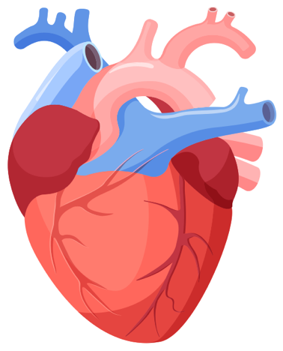


What is Fabry Disease?
  An X-linked multi-systemic, genetic disorder of glycosphingolipid metabolism, with symptoms owing to absent/deficient lysosomal α-Gal A activity¹
  Occurs in both males and females, affecting quality of life^{1,2}
    Of 1077 females enrolled in the global Fabry Registry at the time of analysis, 69.4% of females with Fabry disease experienced signs and symptoms of Fabry disease*³
  Affects multiple body systems, particularly the kidneys, heart, and the central and peripheral nervous systems^{1,4}
  Overt symptoms first manifest in either childhood or adulthood⁴
    Organ damage can occur without overt symptoms, particularly in females, and can become irreversible and potentially life-threatening^{5,6}
*Data as of January 2007 including 1077 women enrolled in the Fabry Registry
α-Gal A, α-galactosidase A
1. Germain DP. Orphanet J Rare Dis 2010;5:30; 2. Wang RY, et al. Genet Med 2007;9:34–45; 3. Wilcox WR, et al. Mol Genet Metab 2008;93:112–128; 4. Schiffmann R, et al. Kidney Int 2017;91:284–293; 5. Moura LA, et al. ASN Kidney Week 2017; Abstract SA-PO628; 6. Niemann M, et al. JACC Cardiovasc Imaging 2011;4:592–601
MAT-US-2100520 v5.0 - P
Expiration Date: 1/22/2027
MAT-US-2100520 v2.0 - P
Expiration Date: 1/31/2025
MAT-US-2100520 v2.0-P
Expiration Date: 1/31/2025
Notes:
Affects multiple systems, including the kidneys, heart, central and peripheral nervous systems, and the skin, ocular, and gastrointestinal systems^{1,4}

Slide 6
Genetic Pathophysiology of Fabry Disease: GLA Gene
  GLA gene is located on chromosome Xq22.1 (long arm of the X-chromosome)¹
    Comprises 7 exons over 12,436 base pairs²
  There is extensive allelic heterogeneity in Fabry disease
    >900 variants reported to date³
  In contrast to other lysosomal disorders (e.g. Gaucher disease), there are generally not prevalent pathogenic variants; most are ‘private’ (i.e. found only in a single family)⁴
GLA, α-galactosidase A
Figure reproduced from: NIH US National Library of Medicine. Available at: https://ghr.nlm.nih.gov/gene/GLA#location. Accessed Dec 2020.
1. NIH US National Library of Medicine. Available at: https://ghr.nlm.nih.gov/gene/GLA#location. Accessed Dec 2020; 2. Germain DP. Orphanet J Rare Dis 2010;5:30;
3. The Human Gene Mutation Database. Available at: http://www.hgmd.cf.ac.uk/ac/gene.php?gene=GLA. Accessed Dec 2020; 4. Wasserstein M & McGovern M. Future Lipidol 2008;3:189–201
MAT-US-2100520 v5.0 - P
Expiration Date: 1/22/2027
MAT-US-2100520 v2.0-P
Expiration Date: 1/31/2025
MAT-US-2100520 v2.0 - P
Expiration Date: 1/31/2025

Slide 7
Types of GLA Variants
VARIANT SEVERITY
  Genotype–phenotype correlation in Fabry disease is variable
  Some variants are reliably
  associated with classic,
  non-classic, or benign phenotypes
  Other GLA variants have unclear phenotypic significance (GVUS)
  Nonsense, consensus splice site, and most frameshift variants result in little or no α-Gal A activity
    These variants are typically associated with classic Fabry disease
  Non-classic phenotype usually results from missense or splicing variants that have residual α-Gal A enzyme activity
E.g. nonsense (p.R227X, p.R220X, p.R342X), frameshift, deletion, and many missense variants
Pathogenic variants, classic phenotype
p.R301Q
p.R363H
Pathogenic variants, non-classic phenotype
p.F113L
p.N215S
c.936+919G>A
p.R112H
p.M296I
Genetic variants of unclear significance (GVUS)
p.R118C
Benign polymorphisms
A143T
p.D313Y p.S126G. p.E66Q
PREVALENCE
Figure adapted with permission from Ortiz A, et al. Mol Genet Metab 2018;123:416–427
Ortiz A, et al. Mol Genet Metab 2018;123:416–427
MAT-US-2100520 v2.0-P
Expiration Date: 1/31/2025
MAT-US-2100520 v5.0 - P
Expiration Date: 1/22/2027
MAT-US-2100520 v2.0 - P
Expiration Date: 1/31/2025
MAT-US-2100520 v2.0-P
Expiration Date: 1/25/2025
7
Notes:
Some key variants associated with the classic or non-classic Fabry disease phenotype, GLA variants of unclear significance, and benign variants. The triangular form illustrates the higher frequency of benign and likely benign variants. Physicians should be aware that, due to this higher frequency, such variants may be seen in screening studies but may not result in Fabry-specific manifestations in all patients.

Slide 8
Biochemical Pathophysiology
Variant in GLA
  X-linked, but 69.4% of females report signs and symptoms of Fabry Disease¹
GLA variants affect α-Gal A by:¹⁰
  Reducing its stability
  Altering active site functionality
  Altering its specificity
Accumulation of GL-3 occurs due to reduced/absent/non-functioning
α-Gal A, leading to:^{5–7}
  Cellular and tissue damage
  Inflammation
  Immune response
  Fibrosis
Deficiency of α-Gal A
  Responsible for breaking down GL-3²
GL-3 accumulation
  Starts before birth³
Cellular dysfunction
  Affecting multiple tissue cell types and the vascular endothelium⁴
Tissue damage/fibrosis
  Occurs before overt clinical signs^{5,6}
Symptoms and
organ failure
  Pain, GI distress, hypohidrosis, renal failure, arrhythmias,
  cardiac failure, stroke⁷
Early death
Approximately 16-year reduction in lifespan for males and a range of 5-14-year reduction in lifespan for females compared with the general population^{8,9}
GI, gastrointestinal; GL-3, globotriaosylceramide.
1. Wilcox WR, et al. Mol Genet Metab 2008;93:112–128; 2. NIH US National Library of Medicine https://ghr.nlm.nih.gov/gene/GLA#location. Accessed Dec 2020; 3. Weidemann F, et al. Ann Rev Med 2011;62:59–67; 4. Desnick RJ, et al. Ann Intern Med 2003;138:338–346; 5. Niemann M, et al. JACC Cardiovasc Imaging 2011;4:592–601; 6. Veloso VSP, et al. Nephron 2018;138:147–156; 7. Ortiz A, et al. Mol Genet Metab 2018;123:416–427; 8. Waldek S, et al. Genet Med 2009;11:790–796; 9. Mehta A, et al. J Med Genet 2009;46:548–552.
MAT-US-2100520 v2.0 - P
Expiration Date: 1/31/2025
MAT-US-2100520 v5.0 - P
Expiration Date: 1/22/2027
MAT-US-2100520 v2.0-P
Expiration Date: 1/31/2025

Slide 9
X-linked Inheritance
  As an X-linked disease, the genetic defect that causes Fabry disease can be transmitted by both males and females^{1–3}
    Sons with a pathogenic GLA variant are affected
    Daughters with a pathogenic GLA variant can
    have variable clinical severity, ranging from asymptomatic to severe disease due to X-inactivation*
Segregation of X-Linked Trait
Male with GLA variant
Male with normal GLA allele
Female with GLA variant
Female with normal GLA alleles
Males pass a GLA variant to all of their daughters and none of their sons²
Females have a 50% chance to pass a GLA variant with
each pregnancy²
*Each cell in a female’s body contains two X chromosomes, but one is not transcribed due to X-inactivation; see slide 42.
Figure is original by A Walter, Sanofi Genzyme, US Medical Affairs
1. Desnick RJ, et al. α-Galactosidase A Deficiency: Fabry Disease. In: Valle D, et al; eds. New York, NY. McGraw Hill, 2001; 2. Germain DP. Orphanet J Rare Dis 2010;5:30; 3. Echeverria L, et al. Clin Genet 2016;89:44
MAT-US-2100520 v5.0 - P
Expiration Date: 1/22/2027
MAT-US-2100520 v2.0 - P
Expiration Date: 1/31/2025
MAT-US-2100520 v2.0-P
Expiration Date: 1/31/2025
Notes:
Lilac highlighting shows male transmission of a GLA variant; rose highlighting shows female transmission

Slide 10
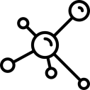




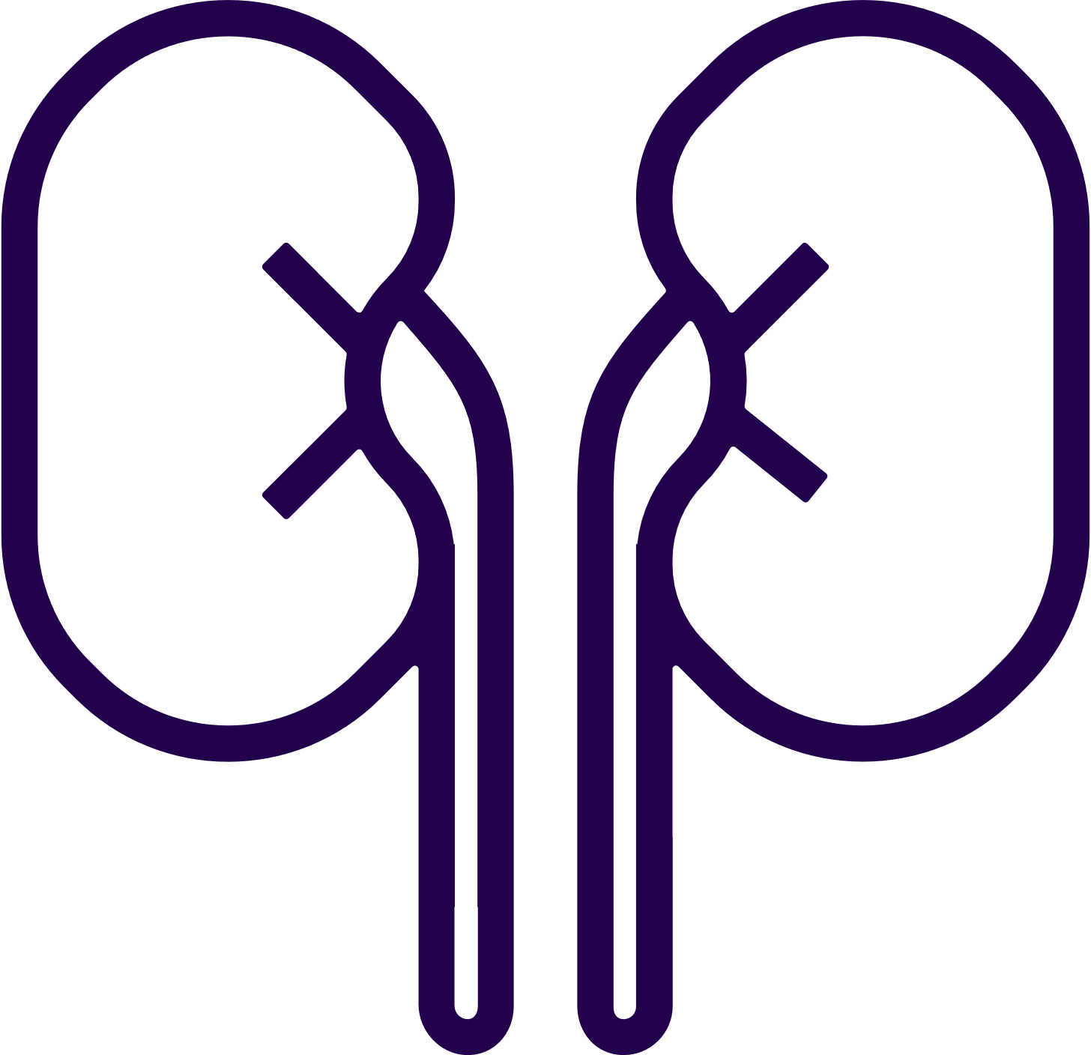



Fabry Disease can be Divided into Classic and Non-Classic/
Later-Onset Phenotypes
Parameter | Classic | Non-Classic/Later-Onset
α-Gal A activity | <1–5% (approximate) in males*^{1–3} | >5–20% approximate in males*^{1,2,4–6}
Age at symptom onset | Childhood/adolescence¹ | ~4th–7th decade of life¹
Presenting symptoms | Neuropathic pain, angiokeratomas, corneal/lenticular opacities, hypohidrosis, GI disturbances^{1,7} | CV symptoms most common; early classic symptoms generally absent^{1,6}
Organ involvement | Multi-organ involvement¹ | Predominantly single-organ involvement¹
Disease progression | Occult kidney injury, can progress to CKD & kidney failure, cardiomyopathy and arrhythmias, stroke /TIA, CV disease, CV death¹ | Generally sufficient residual α-Gal A to protect progression in other organs^{1,8}
α-Gal A, alpha galactosidase A; CKD, chronic kidney disease; CV, cardiovascular; GI, gastrointestinal; TIA, transient ischemic attack
1. Ortiz A, et al. Mol Genet Metab 2018;123:416–427; 2. Arends M, et al. J Am Soc Nephrol 2017;28:1631–1641; 3. Smid BE, et al. J Med Genet 2015;52:262–268; 4. Lukas J, et al. Hum Mutat 2016;37:43–51; 5. Ishii S, et al. Am J Hum Genet 2002;70:994–1002; 6. International Fabry Disease Genotype–Phenotype Database. Available at: http://www.dbfgp.org/dbFgp/fabry/FabryGP.html (Accessed December 2020); 7. Schiffmann R, et al. Kidney Int 2017;91:284–293; 8. Eng CM & Desnick RJ. Hum Mutat 1994;3:103–111.
*Enzyme levels in plasma/WBCs do not correlate with a predictable pattern of disease in females due to mosaicism^{1,2,4,5}
MAT-US-2100520 v5.0 - P
Expiration Date: 1/22/2027
MAT-US-2100520 v2.0 - P
Expiration Date: 1/31/2025

Slide 11
Disease Burden is a Function of Age and Progression:
Classic Fabry Disease
As GL-3 accumulates and organ systems are affected, early symptoms progress to life-threatening complications^{1,2}
  Early symptoms¹
  Cornea verticillate
  Neuropathic pain
  Gastrointestinal symptoms
  Hypohidrosis or anhidrosis
  Exercise/heat/cold intolerance
  Bradycardia
  Angiokeratomas
  Occult kidney injury
Premature death
Burden of Disease
Organ failure
Tissue involvement
Clinical symptoms
GL-3 accumulation
Time
Figure adapted from Eng CM, et al. J Inherit Metab Dis 2007;30:184–192
1. Ortiz A, et al. Mol Genet Metab 2018;123:416–427; 2. Germain DP. Orphanet J Rare Dis 2010;5:30
MAT-US-2100520 v5.0 - P
Expiration Date: 1/22/2027
MAT-US-2100520 v2.0 - P
Expiration Date: 1/31/2025
MAT-US-2100520 v2.0-P
Expiration Date: 1/31/2025
Notes:
Disease burden is a function of age and progression
If left untreated, GL-3 accumulation beginning in utero and continuing throughout life, will progress in a cascade of multi-systemic events that may lead to irreversible tissue damage, organ failure and premature death¹
This burden of disease increases with age while the condition deteriorates¹
Early symptoms include acroparesthesias, episodic pain crises, fatigue, fever, hypo or anhidrosis, exercise intolerance, and gastrointestinal symptoms including pain¹
Late complications are the main cause of morbidity and also premature mortality^{1,2}
Complete citations
Ortiz A, et al. Fabry disease revisited: management and treatment recommendations for adult patients. Mol Genet Metab. 2018; 123(4):416-27.
Germain DP. Fabry disease. Orphanet J Rare Dis. 2010;5:30.

Slide 12
Disease Burden is a Function of Age and Progression:
Non-classic Fabry Disease
As GL-3 accumulates and organ systems are affected,
symptoms occur at later age but still progress to life-threatening complications¹
  Findings in the 4th to 7th decades of life include:^{1–3}
  Cardiac conduction abnormalities
  Left ventricular hypertrophy
  Late gadolinium enhancement on cardiac MRI
  Reduced GFR (although typically with less severe kidney disease compared to patients with classic Fabry disease)
Burden of Disease
Premature
death
Organ failure
Tissue involvement
Clinical symptoms
GL-3 accumulation
Time
*This can occur despite causing very different residual α-Gal A activity levels.
Figure adapted from Eng CM, et al. J Inherit Metab Dis 2007;30:184–192
1. Ortiz A, et al. Mol Genet Metab 2018;123:416–427; 2. Germain, et al. Mol Genet Genomic Med 2018;1–12; 3. Arends M, et al. J Am Soc Nephrol 2017;28:1631–1641.
MAT-US-2100520 v5.0 - P
Expiration Date: 1/22/2027
MAT-US-2100520 v2.0 - P
Expiration Date: 1/31/2025
MAT-US-2100520 v2.0-P
Expiration Date: 1/31/2025
Notes:
It has been reported that cardiac variant patients may have significant levels of residual alpha-Gal A activity (2%–20% of normal) and generally lack the early classic symptoms of Fabry disease (e.g., neuropathic pain, gastrointestinal complaints, angiokeratoma, cornea verticillata), with manifestations being confined to the heart predominantly (left ventricular hypertrophy, conduction disturbances, arrhythmias). These patients generally present later in life than classic patients, or may be diagnosed earlier as a result of neonatal, family or high-risk population screening initiatives.¹
Complete citation
1. Germain DP, et al. Phenotypic characteristics of the p.Asn215Ser(p.N215S) GLA variant in male and female patients with Fabry disease: a multicentre Fabry Registry study. Mol Genet Genomic Med 2018; 1-12.

Slide 13
Some Individuals have a High Risk of Fabry Disease
  Higher risk of Fabry disease:^{1,2}
  Individuals with a family history of
  Fabry disease
  Women of any age with unexplained CKD or males with CKD aged <50 years
  Individuals with idiopathic HCM
Example Fabry Pedigree Analysis
Heterozygous female
with variant
Unaffected female
Affected male
Unaffected male
Proband
  Pedigree analysis and screening of high-risk individuals allows identification of patients with Fabry disease before they become symptomatic^{1–3}
  For every patient with Fabry disease identified via clinical suspicion/screening, there is an average of 5 affected family members whose disease was undetected previously¹
CKD, chronic kidney disease; HCM, hypertrophic cardiomyopathy
Figure reproduced from an image developed by Simon Caulton at: https://commons.wikimedia.org/wiki/File:Sex_linked_inheritance.png. Accessed Dec 2020, and used under the Creative Commons Attribution-Share Alike 3.0 Unported license
1. Laney DA, et al. J Genet Couns 2013;22:555–564; 2. Terryn W, et al. Nephrol Dial Transplant 2013;28:505–517; 3. Silva CA, et al. Nephron 2016;134:221; 4. Maron MS, et al. Am J Med 2018;131:200
MAT-US-2100520 v5.0 - P
Expiration Date: 1/22/2027
MAT-US-2100520 v2.0 - P
Expiration Date: 1/31/2025
MAT-US-2100520 v2.0-P
Expiration Date: 1/31/2025

Slide 14
Fabry Disease Manifestations:
Nephropathy
MAT-US-2100520 v5.0 - P
Expiration Date: 1/22/2027

Slide 15
Renal Injury Progression in Patients with Classic Fabry Disease
GL-3 inclusions increase in podocytes;*
GL-3 also accumulates in other renal cell types including endothelial cells^{1,2}
Classic Fabry Disease
Podocyte injury and fibrosis can occur from early childhood in males²
Less pronounced
in females^{†2}
Renal manifestation onset in 1st or 2nd decade of life²
Pathological
albuminuria →
decreased GFR
(more severe
in males)²
First manifestations of impaired renal function reported at a mean of
23 years in males and
31 years in females³
ESRD occurs in 2%
of females and 14% of males;³ renal
replacement therapy initiated at a median
of 38 years for both males and females⁴
  Non-classic Fabry disease
  Reduced GFR is rare and delayed and may be confused with normal aging^{1,5}
  GL-3 accumulates in podocytes; residual α-Gal A may prevent GL-3 accumulation in other cell types^{1,5}
*Can be seen in patients with classic Fabry with normal estimated GFR and no/low-grade proteinuria; †Owing to podocyte mosaicism as a result of X-linked inactivation in females ESRD, end-stage renal disease; GFR, glomerular filtration rate
1. Najafian B, et al. Kidney Int 2011;79:663–670; 2. Ortiz A, et al. Mol Genet Metab 2018;123(4):416–427; 3. Wilcox WR, et al. Mol Genet Metab 2008;93:112–128;
4. Ortiz A, et al. Nephrol Dial Transplant 2010;25:769–775; 5. Meehan SM, et al. Am J Kidney Dis 2004;43:164–171
MAT-US-2100520 v5.0 - P
Expiration Date: 1/22/2027
MAT-US-2100520 v2.0 - P
Expiration Date: 1/31/2025
MAT-US-2100520 v2.0-P
Expiration Date: 1/31/2025

Slide 16

Case #1: Presentation
  A 32-year-old male was referred to nephrology with a 3-week history of
  non-specific symptoms after a trip to Turkey :
    fever
    abdominal pain
    cough
    exertional shortness of breath
  No significant medical or family history
What initial investigations would you suggest?
Burton JO, et al. BMC Nephrology 2012;13:73–77
MAT-US-2100520 v5.0 - P
Expiration Date: 1/22/2027
MAT-US-2100520 v2.0 - P
Expiration Date: 1/31/2025
MAT-US-2100520 v2.0-P
Expiration Date: 1/31/2025

Slide 17
Case #1: Initial Investigations
  Work-up showed:
    WBC count 13.8 x 10⁹/L
    CRP 278 mg/L
    Urine protein: creatinine ratio 285 mg/dL (normal level <30 mg/dL)
    Cardiomegaly on chest X-ray; pericardial effusion on echocardiogram
    Splenomegaly with normal appearing kidneys on sonogram
  Treatment for atypical infection improved WBC and CRP levels, but creatinine continued to rise
What would be your next steps?
CRP, C-reactive protein; WBC, white blood cell
Burton JO, et al. BMC Nephrology 2012;13:73–77
MAT-US-2100520 v5.0 - P
Expiration Date: 1/22/2027
MAT-US-2100520 v2.0 - P
Expiration Date: 1/31/2025
MAT-US-2100520 v2.0-P
Expiration Date: 1/31/2025

Slide 18
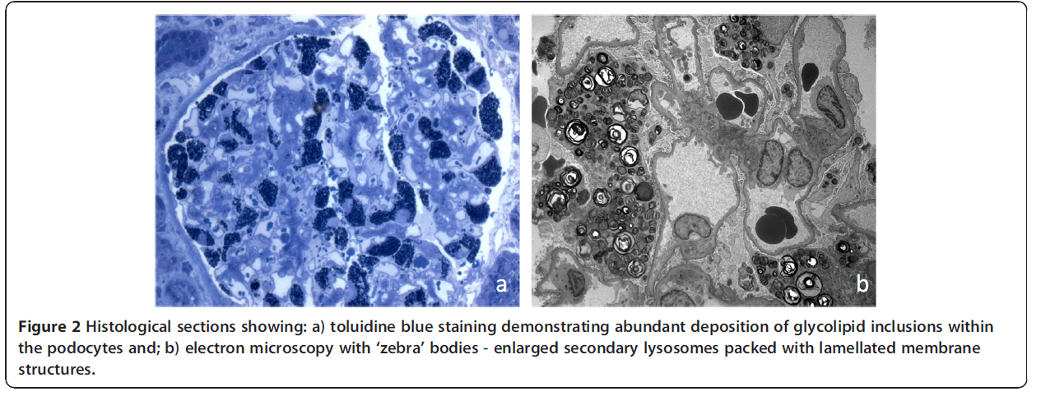
Case #1: Histology
Histological Sections from Subsequent Renal Biopsy
  (a) toluidine blue staining demonstrating
  abundant deposition of glycolipid inclusions
  within the podocytes
  (b) electron microscopy with ‘zebra’
  bodies – enlarged secondary lysosomes packed
  with lamellated membrane structure
What would be in your differential diagnosis?
Images used with permission.
Burton JO, et al. BMC Nephrology 2012;13:73–77
MAT-US-2100520 v5.0 - P
Expiration Date: 1/22/2027
MAT-US-2100520 v2.0 - P
Expiration Date: 1/31/2025
MAT-US-2100520 v2.0-P
Expiration Date: 1/31/2025

Slide 19
Case #1: Diagnosis
  Suspicion of Fabry disease was prompted by histology:
    Abundant deposition of glycolipid in kidney podocytes
    Presence of ‘zebra’ bodies
  α-Gal A activity tests confirmed the diagnosis:
    Dried blood spot: 3.61 pmol/spot/h (NR 5.51–58.1 pmol/spot/h)
    Plasma: 1.88 µmol/L/h (NR 3–20 µmol/L/h)
  GLA gene sequencing revealed a missense point mutation
  Patient became dialysis dependent over the next 6 months
Although signs and symptoms weren’t suggestive of Fabry disease,
the clinician was vigilant and diagnosed based on histology
Would you have considered Fabry disease?
NR, normal range.
Burton JO, et al. BMC Nephrology 2012;13:73–77
MAT-US-2100520 v5.0 - P
Expiration Date: 1/22/2027
MAT-US-2100520 v2.0 - P
Expiration Date: 1/31/2025
MAT-US-2100520 v2.0-P
Expiration Date: 1/31/2025

Slide 20
Fabry Disease Manifestations:
Cardiovascular
MAT-US-2100520 v5.0 - P
Expiration Date: 1/22/2027

Slide 21


Cardiovascular Manifestations of Classic Fabry Disease
Progression of cardiac manifestations over time
Classic Fabry Disease
Early asymptomatic¹
PR interval changes
Resting bradycardia
3rd decade of life onwards¹
Cardiomyopathy (LVH)
Myocardial fibrosis
T-wave inversion
4th/5th decade of life onwards^{1,2}
Reduced exercise tolerance
Atrial fibrillation
Ventricular tachycardia
Heart failure*
Sudden cardiac death
  Cardiomyopathy typically develops ~10 years later in females than in males³
  50–57% of females with Fabry disease die because of cardiovascular disease at a median age of 66 years**^{4,5}
  In contrast to Fabry disease, in the general population, heart disease is the leading cause of death occurring in 21.8% of females (all ages) in the United States⁶
PR interval is the period extending from the beginning of the P wave (onset of atrial depolarization) until the start of the QRS complex (onset of ventricular depolarization). *Mostly with a preserved ejection fraction, i.e. inability of the heart to pump blood with normal efficiency; in Fabry disease this is usually congestive heart failure due to diastolic dysfunction and left ventricular stiffness with preserved ejection fraction, i.e. blood volume pumped from left ventricle remains >50% of normal. LVH, left ventricular hypertrophy.
** Data based on 1426 women enrolled in the Fabry Registry and 754 enrolled in the Fabry Outcome Survey^{4,5}
1. Ortiz A, et al. Mol Genet Metab 2018;123(4):416–427; 2. Kramer J, et al. Am J Cardiol 2014;114:895–900; 3. Kampmann C, et al. Int J Cardiol 2008;130:367–373; 4. Waldek S, et al. Genet Med 2009;11:790–796; 5. Mehta A, et al. J Med Genet 2009;46:548–552; 6. Centers for Disease Control and Prevention. Leading causes of death. Available at: https://www.cdc.gov/women/lcod/2017/all-races-origins/index.htm. Accessed November 2021
MAT-US-2100520 v5.0 - P
Expiration Date: 1/22/2027
MAT-US-2100520 v2.0 - P
Expiration Date: 1/31/2025
MAT-US-2100520 v2.0-P
Expiration Date: 1/31/2025
Notes:
Left heart valves are predominantly affected, even though the pathological accumulation of GL-3 is present in both sides of the heart¹
Can be explained by the increased pressure in the left heart leading to a more rapid deterioration of the mitral and aortic valves
¹Putko BN, et al. Heart Fail Rev 2015; 20:179–191

Slide 22

Cardiovascular Manifestations of Non-classic Fabry Disease
Progression of cardiac manifestations over time
Cardiomyopathy has delayed onset and
slowed disease progression in non-classic
versus classic Fabry disease¹
4th–7th decade of life¹
LVH
Arrhythmias
Abnormalities on cardiac MRI
  The non-classic N215S missense variant has predominant cardiac manifestations, including LVH and HCM,that can be as severe as seen in patients with classic Fabry disease^{2,3}
MRI, magnetic resonance imaging
1. Ortiz A, et al. Mol Genet Metab 2018;123(4):416–427; 2. Germain DP, et al Mol Genet Genomic Med 2018;6:492–503; 3. Patel V, et al. Heart 2015;101:961–966
MAT-US-2100520 v5.0 - P
Expiration Date: 1/22/2027
MAT-US-2100520 v2.0 - P
Expiration Date: 1/31/2025
MAT-US-2100520 v2.0-P
Expiration Date: 1/31/2025

Slide 23
Ventricular Hypertrophy in Fabry Disease
  Hypertrophic cardiomyopathy is common in classic and non-classic Fabry disease
  Symptoms and complications include:¹
    Dyspnea, palpitations, and heart murmur
    Atrial fibrillation, heart failure, and sudden cardiac death¹
  53% of males and 33% of females with Fabry disease develop LVH² vs 1–5% of the general population³
  RVH is not well characterized in Fabry disease but occurs in ~1/3 of patients
    Predominantly occurs in males with concomitant LVH⁴
  T1 resonance is reduced in LVH and RVH in patients with Fabry disease, indicating that these manifestations possibly share a common pathology⁵
  Fabry RVH does not affect right ventricular systolic function to the same extent as infiltrative heart disease, facilitating differential diagnosis⁴
RVH, right ventricular hypertrophy
1. Mayo Clinic 2018. Available at: https://www.mayoclinic.org/diseases-conditions/hypertrophic-cardiomyopathy/symptoms-causes/syc-203501982 Accessed Dec 2020; 2. Linhart A, et al. Eur Heart J 2007;28:1228–1235; 3. Iribarren C, et al. J Am Heart Assoc 2017;6:e004954; 4. Graziani F, et al. J Am Soc Echocardiogr 2017;30:282; 5. Pagano JJ, et al. PLoS One 2016;11:e0157565
MAT-US-2100520 v5.0 - P
Expiration Date: 1/22/2027
MAT-US-2100520 v2.0 - P
Expiration Date: 1/31/2025
MAT-US-2100520 v2.0-P
Expiration Date: 1/31/2025
Notes:
HCM is a disease in which the heart muscle becomes abnormally thick; in Fabry this generally affects the muscle surrounding the left ventricle, and HCM is therefore often referred to as LVH.

Slide 24
Role of Cardiac MRI in the Diagnosis of Fabry Disease
  Clinical relevance of conventional cardiac MRI¹
  In males, LGE indicating myocardial fibrosis coincides with LVH development
  In females, LGE indicating myocardial fibrosis can occur in the absence of LVH
  Cardiac MRI with gadolinium should be the
  first-line diagnostic approach in the cardiac evaluation of women with Fabry disease
Functional abnormalities
Increasing wall thickness
Aging
Replacement fibrosis
Aging
Cardiomyopathy disease progression in male and female patients with Fabry disease
Functional abnormalities
Aging
Increasing wall thickness
Replacement fibrosis
Figure reproduced from Niemann M, et al. JACC Cardiovasc Imaging 2011;4:592–601
LGE, late-phase gadolinium enhancement; MRI, magnetic resonance imaging
1. Niemann M, et al. JACC Cardovasc Imaging 2011;4:592–601
MAT-US-2100520 v5.0 - P
Expiration Date: 1/22/2027
MAT-US-2100520 v2.0 - P
Expiration Date: 1/31/2025
MAT-US-2100520 v2.0-P
Expiration Date: 1/31/2025
Notes:
In male patients, the left ventricle starts to hypertrophy during adolescence, and this is accompanied by reduced longitudinal function. During aging, these 2 features lead to
replacement fibrosis.
Cardiomyopathy disease progression in female patients is different. In contrast to male patients, the 3 hallmarks cannot be described as a temporal sequence toward fibrosis. In contrast, it is
more a vicious circle: the progression toward hypertrophy is prolonged, whereas the development of fibrosis and regional functional abnormalities progresses simultaneously.

Slide 25
Case #2: Presentation
  A 64-year-old man presented with atypical,
  non-exercise-induced chest pain and palpitations
  His medical history was unremarkable with no reports of:
    acroparesthesia
    chronic pain
    gastrointestinal problems
    skin lesions
    stroke
  His mother experienced unexplained sudden cardiac death at age 42 years
  What would be your next steps with this patient?
Nunes JP, et al. Nat Clin Pract Cardiovasc Med 2007;4:630–633
MAT-US-2100520 v5.0 - P
Expiration Date: 1/22/2027
MAT-US-2100520 v2.0 - P
Expiration Date: 1/31/2025
MAT-US-2100520 v2.0-P
Expiration Date: 1/31/2025

Slide 26
Case #2: Investigations
  Electrocardiogram
    Sinus rhythm
    Normal PR interval (143 ms)
    Left anterior fascicular block
    High voltage of QRS complex
    Abnormal repolarization, including negative T-waves in the left precordial leads
  Echocardiogram:
    Marked concentric LVH
    Normal left ventricular systolic function
  Myocardial perfusion scintillation:
    Normal perfusion
    LVEF of 49%
  Blood pressure 170/100 mmHg
LVEF, left ventricular ejection fraction
Nunes JP, et al. Nat Clin Pract Cardiovasc Med 2007;4:630–633
MAT-US-2100520 v5.0 - P
Expiration Date: 1/22/2027
MAT-US-2100520 v2.0 - P
Expiration Date: 1/31/2025
MAT-US-2100520 v2.0-P
Expiration Date: 1/31/2025

Slide 27
Case #2: Diagnosis
  On follow-up 2.5 years later, patient’s blood pressure had normalized but his LVH persisted
  Mild proteinuria was noted: 0.164 g/24 h (upper NR 0.15 g/24h)
  Fabry disease was diagnosed by enzyme activity test
  On molecular testing, the Phe113Leu pathogenic variant was discovered – a non-classic cardiac variant
  Would the patient’s family history have raised suspicion of Fabry disease with you?
  Even in the absence of signs typical of classic Fabry disease?
Nunes JP, et al. Nat Clin Pract Cardiovasc Med 2007;4:630–633
MAT-US-2100520 v5.0 - P
Expiration Date: 1/22/2027
MAT-US-2100520 v2.0 - P
Expiration Date: 1/31/2025
MAT-US-2100520 v2.0-P
Expiration Date: 1/31/2025

Slide 28
Fabry Disease Manifestations: CNS/PNS
MAT-US-2100520 v5.0 - P
Expiration Date: 1/22/2027

Slide 29
Neurologic Manifestations in Fabry Disease: Overview
Neurologic issues occur due to small fiber damage; vasculopathy and inflammation of the arteries; Schwann cell, dorsal root and hippocampal ganglion GL-3 accumulation; and white matter lesions^{1–3}
Stroke
Hypohidrosis/
anhidrosis
Low tolerance of cold/heat
Cognitive changes
Depression
Neuropathic pain and pain crises
Asthenia and deambulation
Related GI issues
Figure developed based on: Bolsover FE, et al. J Inherit Metab Dis 2014;37:177–187; Chimenti C, et al. Hum Pathol 2012;43:1444–1452; Ortiz, et al. Mol Genet Metab 2018;123:416–427; Politei JM, et al. CNS Neurosci Ther 2016;568–576; Sims K, et al. Stroke 2009;40:788–794
1. Schiffmann R & Moore DS. Fabry disease: perspectives from 5 years of FOS. In: Mehta A, et al; eds. Oxford: Oxford PharmaGenesis Ltd, 2006; Chapter 22; 2. Dutsch M, et al. J Clin Neurophysiol 2002;19:575–586; 3. Ortiz, et al. Mol Genet Metab 2018;123:416–427
MAT-US-2100520 v5.0 - P
Expiration Date: 1/22/2027
MAT-US-2100520 v2.0 - P
Expiration Date: 1/31/2025
MAT-US-2100520 v2.0-P
Expiration Date: 1/31/2025

Slide 30
Neurologic Manifestations in Fabry Disease:
Peripheral Nervous System
  Patients with Fabry disease can experience:¹
    Burning, stabbing, tingling, and proximally radiating shooting pain in their extremities
    Pain crises – attacks of excruciating, incapacitating pain
    Pain evoked by heat, cold, and fever
    Greater sensitivity to pain
  Fabry-related pain is most frequently reported
  in the:²
    Hands – females 60%; males 76%
    Feet – females 52%; males 73%
  Less frequent pain sites (joints)
  Typical sites of Fabry disease pain (fingers, palms, toes, soles of feet)
Figure based on: Politei JM, et al. CNS Neurosci Ther 2016;568–576
1. Politei JM, et al. CNS Neurosci Ther 2016;22:568–576; 2. Hoffmann B, et al. Clin J Pain 2007;23:535–542
MAT-US-2100520 v5.0 - P
Expiration Date: 1/22/2027
MAT-US-2100520 v2.0 - P
Expiration Date: 1/31/2025
MAT-US-2100520 v2.0-P
Expiration Date: 1/31/2025

Slide 31
Neurologic Manifestations in Fabry Disease: Stroke
  In patients with Fabry disease, stroke occurs:¹
    Before Fabry disease diagnosis in 38% of women and 50% of men
    In the absence of other key Fabry disease symptoms in 71% of women and 77% of men
  The basilar artery at the front of the brainstem undergoes major changes* in patients with Fabry disease²
    Changes only become significant in females with Fabry disease after age 45 years²
    Coincides with mean age of first stroke in females (46 years)¹
Age at First Stroke in Males and Females With Fabry Disease¹
n=25
n=20
n=11
n=20
n=18
n=12
% patients
n=10
n=10
n=8
n=1
n=1
n=2
Age at first stroke, years
Figure reproduced with permission from Sims K, et al. Stroke 2009;40:788–794
*Increased diameter, tortuosity, and length
1. Sims K, et al. Stroke 2009;40:788–794; 2. Manara R, et al. Am J Neuroradiol 2017;38:531–536
MAT-US-2100520 v5.0 - P
Expiration Date: 1/22/2027
MAT-US-2100520 v2.0 - P
Expiration Date: 1/31/2025
MAT-US-2100520 v2.0-P
Expiration Date: 1/31/2025

Slide 32
Fabry Disease
Manifestations: Other
For use by medical for scientific and medical discussions only. Do not photograph, copy or distribute.
MAT-US-2100520 v5.0 - P
Expiration Date: 1/22/2027

Slide 33
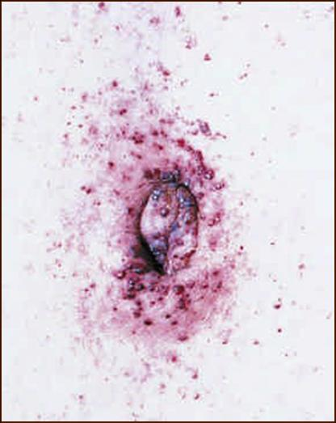
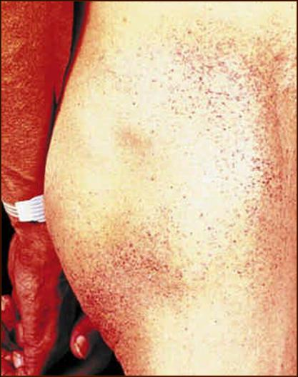
Skin Manifestations of Fabry Disease
  Angiokeratoma – pin-sized, reddish brown marks on:¹
    Fingertips
    Groin and buttocks
    Periumbilical area
    Mucosa (e.g. gastrointestinal tract)
  Telangiectasia – thread-like patterns¹
  Lymphedema – fluid retention¹
  Sweating disturbance¹
    Hypohidrosis (most common)
    Anhidrosis
  GL-3 skin deposits are specific to classic Fabry disease and skin GL-3 load increases with advanced disease in males^{2,3}
Angiokeratomas
Photos courtesy of R. J. Desnick, PhD, MD.
1. Hoffmann B, Mayatepak E. Dtsch Arztebl Int 2009;106:440­; 2. Ligouri R, et al. PLoS One 2017;12:e0180581; 3. Uceyler N, et al. PLoS One 2016;11:e0166484
MAT-US-2100520 v2.0 - P
Expiration Date: 1/31/2025
MAT-US-2100520 v5.0 - P
Expiration Date: 1/22/2027
MAT-US-2100520 v2.0-P
Expiration Date: 1/31/2025

Slide 34
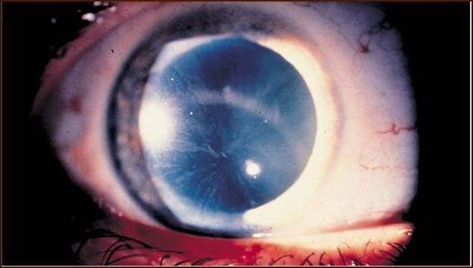
Ocular Manifestations of Fabry Disease
  Ocular findings occur in ~ 50% of school-aged children with classic Fabry disease¹:
    Corneal opacity/whorls (verticillata): 53/101 (52.5%) girls and 55/131 (42.0%) boys
    Vessel tortuosity in 17/98 (17.3%) girls and 32/131 (24.4%) boys
    Posterior spoke-like lens opacities in 3/97 (3.1%) girls and 2/130 (1.5%) boys
    Disease severity is greater in Fabry patients with ocular signs vs Fabry patients without ocular signs²
    Eye findings are more common in patients with classic Fabry disease variants versus patients with non-classic GLA variants
“Whorl-like” or “spoke-like” corneal opacities
Tortuous retinal vessels
Cornea verticillate photo courtesy of RJ Desnick, PhD, MD. Tortuous retinal vessel photo reproduced from Kalkum G, et al. PLoS One 2015;10:e0120814
1. Kalkum G, et al. BMC Ophthalmol 2016;16:202; 2. Pitz S, et al. PLoS One 2015;10:e0120814
MAT-US-2100520 v5.0 - P
Expiration Date: 1/22/2027
MAT-US-2100520 v2.0-P
Expiration Date: 1/31/2025
MAT-US-2100520 v2.0 - P
Expiration Date: 1/31/2025

Slide 35
Auditory Manifestations of Fabry Disease
  GL-3 accumulation in the audiovestibular ganglia and cochlear vessels occurs in most patients with Fabry disease, damaging auditory and vestibular function¹
  Slow, progressive hearing loss (in both ears and at all frequencies) and tinnitus can develop in patients with Fabry disease, although both can go unnoticed¹
Prevalence of Audiovestibular Symptoms in Fabry Disease
  Symptomatic hearing loss (18–59%)²
  Vertigo + hearing loss (25%)³
  Vertigo
  (28%)³
  Tinnitus
  (17–18%)²
  Sudden deafness
  (6–36%)²
  In patients with Fabry disease, hearing loss:
    develops more rapidly at higher than at lower frequencies¹
    is worse at all frequencies compared with control subjects*⁴
    is more common in males than females¹
*Adjusted for age
1. Hoffmann B, Mayatepak E. Dtsch Arztebl Int 2009;106:440­; 2. Suntjens EB, et al. J Inherit Metab Dis 2015;38:351–358; 3. Carmona S, et al. Audiol Res 2017;7:176; 4. Rodrigues J, et al. Eur J Med Genet 2018;61:341
MAT-US-2100520 v5.0 - P
Expiration Date: 1/22/2027
MAT-US-2100520 v2.0 - P
Expiration Date: 1/31/2025
MAT-US-2100520 v2.0-P
Expiration Date: 1/31/2025

Slide 36
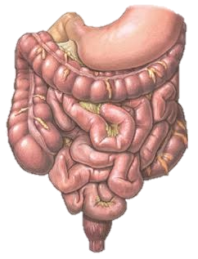
Gastrointestinal Manifestations of Fabry Disease
  GI symptoms occur in 69% of males and 58% of females^{1,2} and include:^{3–5}
  Episodic diarrhea
  Nausea
  Vomiting
  Bloating
  Post-prandial discomfort
  Cramping abdominal pain
  Intestinal malabsorption
  Radiographic studies of the gastrointestinal system reveal:³
  Thickened, edematous colonic folds
  Mild dilatation of the small bowel
  A granular-appearing ileum
  Loss of haustral markings throughout the colon
  Gastrointestinal symptoms in Fabry disease:
  May be due to neuropathic and myopathic changes leading to gastrointestinal dysmotility⁵
  May be caused by GL-3 deposition in autonomic ganglia of bowels and intestinal vessels³
Image from https://medlineplus.gov/ency/imagepages/9790.htm Accessed Aug 2018
1. MacDermot KD, et al. J Med Genet 2001;38:750–760; 2. MacDermot KD, et al. J Med Genet 2001;38:769–775; 3. Mehta A & Hughes DA. Gene Reviews 2017. Available at: https://www.ncbi.nlm.nih.gov/books/NBK1292/Accessed Dec 2020; 4. Hoffmann B, Mayatepak E. Dtsch Arztebl Int 2009;106:440; 5. Zar-Kessler C, et al. Ther Adv Gastroenterol 2016;9:626
MAT-US-2100520 v2.0 - P
Expiration Date: 1/31/2025
MAT-US-2100520 v5.0 - P
Expiration Date: 1/22/2027
MAT-US-2100520 v2.0-P
Expiration Date: 1/31/2025

Slide 37
Pulmonary Manifestations of Fabry Disease
  Bronchial obstruction occurs in 46% of adult patients with Fabry disease¹
  Likely due to lysosomal accumulation of GL-3 in bronchial mucosa and smooth-muscle cells, resulting in small and medium airway narrowing²
  Pulmonary function tests should be included in Fabry disease monitoring^{1,2}
Pulmonary manifestations in patients with Fabry disease show a continuum of severity²
  Non-classic females
  Classic females
  Non-classic males
  Classic males
1. Franzen DP, et al. PLoS One 2017;12:e0180437; 2. Franzen D, et al. BMJ Open Respir Res 2018;5:e000277
MAT-US-2100520 v2.0 - P
Expiration Date: 1/31/2025
MAT-US-2100520 v5.0 - P
Expiration Date: 1/22/2027
MAT-US-2100520 v2.0-P
Expiration Date: 1/31/2025

Slide 38
Case #3: Presentation
  A 40-year-old presents as an outpatient with CKD
  Patient reports occasional discomfort in hands and feet
  Medical history shows multiple TIAs at 23 and 27 years
  At 37 years, the patient was hospitalized for an episode
  of severe angina and palpitations
  LVH was diagnosed by echocardiography
  CKD workup during hospitalization:
  Proteinuria 1.2 g/24 h
  Blood pressure 130/70 mmHg
  Serum creatinine 2.3 mg/dl
  Serum albumin 4.2 g/dL
  GFR 35 ml/min/1.73²
Pisani A, et al. BMC Cardiovascular Dis 2012;12:39
MAT-US-2100520 v2.0 - P
Expiration Date: 1/31/2025
MAT-US-2100520 v5.0 - P
Expiration Date: 1/22/2027
MAT-US-2100520 v2.0-P
Expiration Date: 1/31/2025

Slide 39
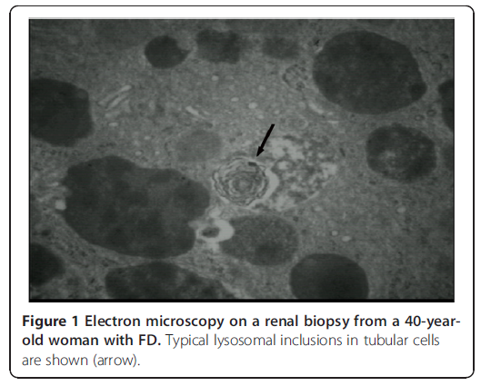
Case #3: Investigation
  At most recent clinic visit:
    Persistent proteinuria and impaired renal function resulted in renal biopsy
    Cardiac morphology was further characterized
  cMRI
  Significantly prolonged myocardial T2 relaxation time (MT2RT) throughout the LV myocardium
  Ejection fraction 53%
  LV mass of 128 g
  Wall thickness:
  inter-ventricular septal 14 mm
  postero-lateral 15 mm
Electron microscopy on a renal biopsy from a
40-year-old patient with Fabry disease. Typical lysosomal inclusions in tubular cells are shown (arrow).
cMRI, cardiac magnetic resonance imaging; LV, left ventricle; MT2RT, myocardial T2 relaxation time
Pisani A, et al. BMC Cardiovascular Dis 2012;12:39
Images used with permission.
MAT-US-2100520 v5.0 - P
Expiration Date: 1/22/2027
MAT-US-2100520 v2.0 - P
Expiration Date: 1/31/2025
MAT-US-2100520 v2.0-P
Expiration Date: 1/31/2025

Slide 40

Case #3: Diagnosis
  Owing to the results of the renal biopsy, cMRI, and the patient’s clinical history suggesting Fabry disease, the patient underwent α-Gal A enzymatic and GLA gene molecular analysis
  α-Gal A enzyme activity was near normal
  GLA gene sequencing showed a pathogenic variant
  Does it surprise you to learn that this individual is a woman?
  Should we be concerned that her α-Gal A enzyme activity level was near normal?
Pisani A, et al. BMC Cardiovascular Dis 2012;12:39
MAT-US-2100520 v2.0 - P
Expiration Date: 1/31/2025
MAT-US-2100520 v5.0 - P
Expiration Date: 1/22/2027
MAT-US-2100520 v2.0-P
Expiration Date: 1/31/2025

Slide 41
Fabry Disease in Females
MAT-US-2100520 v5.0 - P
Expiration Date: 1/22/2027

Slide 42
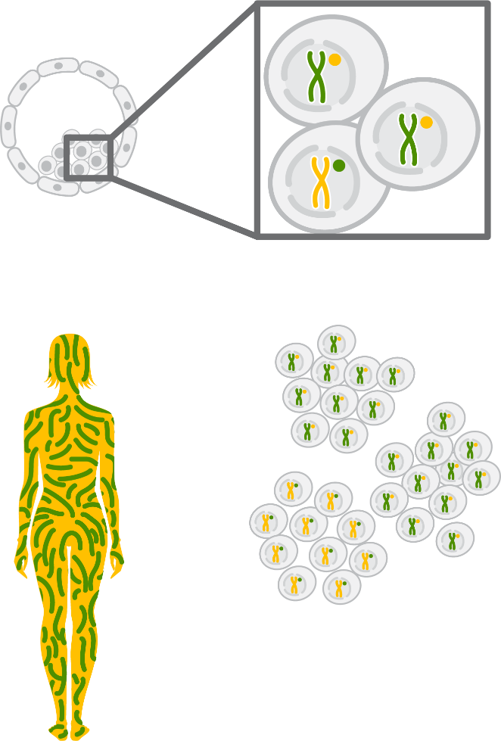
X-inactivation Partially Accounts for Wide Symptom Variation in Females with Fabry
  Each somatic cell in a female’s body contains
  two X chromosomes
    Early in embryonic development, one X chromosome is inactivated via a process called lyonization¹
  Females are referred to as mosaics because some cells express the variant GLA allele while other cells express the wild-type allele^{1–4}
  Usual ‘random’ (50:50 wild-type: variant)
  X-inactivation may prevent a female with a Fabry-associated GLA variant from developing symptoms²
Development of Cellular Mosaicism
with X-inactivation⁵
Barr body
Random selection in each cell with X chromosomes that remain active
Inactivation takes place in the early embryo
Each cell generates a clone, with the same X chromosome active
A woman is a mosaic of cloned cells, each with either a maternally derived or paternally derived X chromosome
Figure reproduced from New Clinical Genetics 3e, with kind permission from Scion Publishing Ltd, © 2015
1. Germain DP. Orphanet J Rare Dis 2010;5:30; 2. Echeverria L, et al. Clin Genet 2016;89:44; 3. Lyon MF. Nature 1961;190:372–373; 4. Lyon MF. Acta Paediatr 2002;91(Suppl 439):107–112; 5. Chapter 7 New Clinical Genetics by Read & Donnai. Available at: http://www.scionpublishing.com/resources/newclinicalgenetics/07-Clinical%20Genetics-ch07-ppp.pdf Accessed Dec 2020
MAT-US-2100520 v5.0 - P
Expiration Date: 1/22/2027
MAT-US-2100520 v2.0 - P
Expiration Date: 1/31/2025
MAT-US-2100520 v2.0-P
Expiration Date: 1/31/2025

Slide 43
Prevalence of Fabry Disease in Females
  Accurate estimation of Fabry disease occurrence in females is challenging due to:^{1–4}
    Phenotypic heterogeneity
    Delayed/under diagnosis
    Variable presentation
    Non-specific symptoms
    Spectrum of pathogenic variants
    Occurrence of variants of uncertain significance
?
  Screening studies report a Fabry disease frequency of ~1:40,000 males⁵
    As the GLA gene is located on the X-chromosome, females would be expected to have double the prevalence of Fabry vs males (1:20,000 vs 1:40,000)⁶
  The prevalence of non classic disease is likely higher in females. Historically prevalence was based on classic phenotypes and did not take into account patients with non classic.
GVUS, genetic variants of unclear significance
1. Dobyns WB. Acta Paediatr 2006;95(Suppl):11–15; 2. Gibas AL, et al. J Genet Counsel 2008;17:528­­–537; 3. Ortiz, et al. Mol Genet Metab 2018;123:416–427; 4. Wilcox WR, et al. Mol Genet Metab 2008;93:112–128 5. Desnick RJ, et al. α-Galactosidase A Deficiency: Fabry Disease. In: Valle D, et al; eds. New York, NY. McGraw Hill, 2001; 6. Laney DA & Fernhoff PM. J Genet Couns 2008;17:79–83
MAT-US-2100520 v5.0 - P
Expiration Date: 1/22/2027
MAT-US-2100520 v2.0 - P
Expiration Date: 1/31/2025
MAT-US-2100520 v2.0-P
Expiration Date: 1/31/2025

Slide 44
Clinical Challenge of Fabry Disease
MAT-US-2100520 v5.0 - P
Expiration Date: 1/22/2027

Slide 45


Challenge of Fabry Disease Diagnosis
Complex Diagnosis¹
  Heterogeneous and variable clinical course²
  Rare disease with lack of awareness in the clinical community¹
  Patients present at non-specialist therapeutic units¹
  A wide range of physicians could be responsible for the diagnosis,
  referral, and/or management of patients with Fabry disease³
  Additional Challenges in Females¹
  Symptom variability is particularly pronounced⁴
  Devalued status with some clinicians as ‘carriers’¹
  Gender inequality persists in healthcare provision¹
    In medicine generally, females are referred for medical care less often and are
    managed less aggressively than men
  Females are more likely than males to have their symptoms ascribed to psychosomatic illness¹
1. Gibas AL, et al. J Genet Counsel 2008;17:528­­–537; 2. Hoffmann B, Mayatepak E. Dtsch Arztebl Int 2009;106:440­–447; 3. Lidove, et al. Clin Genet 2012;81(6):571–577;
4. Dobyns WB. Acta Paediatr 2006;95:11–15
MAT-US-2100520 v5.0 - P
Expiration Date: 1/22/2027

Slide 46
Duration of Diagnostic Delay
  Misdiagnoses and diagnostic delays are common and permit progressive, irreversible tissue damage¹
  Fabry Registry data:²
  Median age at symptom onset
  is 9 years for males and
  13 years for females
  Median age of diagnosis is
  24 years in males and 31 years
  in females
  Delays occurred despite 76.6% of males and 84.1% of females having a family history of Fabry disease
Females
Males
70
70
60
60
50
50
40
40
Median Age (Years)
Median Age (Years)
30
31 y
30
24 y
20
20
13 y
10
10
9 y
0
0
Symptom Onset
n=581
Diagnosis
n=1018
Symptom Onset
n=890
Diagnosis
n=1123
Figure reproduced with permission from Wilcox WR, et al. Mol Genet Metab 2008,93:112–128
1. Ellaway C. Transl Pediatr 2016;5:37–42; 2. Wilcox WR, et al. Mol Genet Metab 2008,93:112–128
MAT-US-2100520 v2.0 - P
Expiration Date: 1/31/2025
MAT-US-2100520 v5.0 - P
Expiration Date: 1/22/2027
MAT-US-2100520 v2.0-P
Expiration Date: 1/31/2025

Slide 47
Fabry Disease in Differential Diagnosis
Fabry disease should be considered in the differential diagnosis of:¹
  Frequent Fevers of Unknown Origin
  Neuropathic Pain in Extremities
  Angiokeratoma in Bathing Trunk Area
  Renal disease of unknown origin
  LVH of unknown origin
  Stroke of unknown origin
Misleading Fabry Disease Symptoms Can Result in Misdiagnosis¹
Fabry Disease Symptom | Potential Misdiagnosis
Abdominal pain | Acute appendicitis
Neuropathic pain | Erythromelalgia/growing pains
Acute pain with no apparent cause | Neurosis
Pain/temperature sensitivity in extremities | Raynaud’s syndrome
Angiokeratoma | Lupus/petechiae
Joint pain and elevated erythrocyte sedimentation rate | Juvenile or rheumatoid arthritis
Gastrointestinal issues | Chronic fatigue syndrome/lupus/celiac disease
CNS involvement/white matter lesions | Multiple sclerosis*
*7% of patients with Fabry-related neurologic issues are misdiagnosed with multiple sclerosis due to similar changes on MRI; as multiple sclerosis is most common in young women, females with Fabry with neurologic issues are most likely to be misdiagnosed^{2–3} LVH: left ventricular hypertrophy
1. Lidove O, et al. Clin Genet 2012;81:571-577; 2. Colomba P, et al. Oncotarget 2018;9:7758–7762; 3. Bottcher T, et al. PLoS One 2013;8:e71894
MAT-US-2100520 v5.0 - P
Expiration Date: 1/22/2027
MAT-US-2100520 v2.0 - P
Expiration Date: 1/31/2025
MAT-US-2100520 v2.0-P
Expiration Date: 1/31/2025

Slide 48
Increasing Vigilance for Fabry Disease Increases Diagnosis
Lack of awareness is a major hurdle in the diagnosis of Fabry disease, even in high-risk populations^{1,2}
  In a Portuguese study, ~50% of patients with HCM and risk factors for Fabry disease
  did not undergo diagnostic testing due to a lack of awareness among cardiologists¹
  In a study conducted in France, cardiologists not previously clinically vigilant for
  Fabry disease were given targeted information and screening kits²
    Two new Fabry disease cases were found in a population of
    55 patients with HCM after the educational initiative
Raising awareness of Fabry disease and improving clinical understanding is vital in increasing diagnosis^{1,2}
1. Brito D, et al. Rev Port Cardiol 2018;22:pii.S0870-2551; 2. Savary AL, et al. Open Heart 2017;4:e000567
MAT-US-2100520 v5.0 - P
Expiration Date: 1/22/2027
MAT-US-2100520 v2.0-P
Expiration Date: 1/31/2025
MAT-US-2100520 v2.0 - P
Expiration Date: 1/31/2025

Slide 49
Diagnosis and Monitoring of Fabry Disease
MAT-US-2100520 v5.0 - P
Expiration Date: 1/22/2027

Slide 50
Diagnosing Fabry Disease Based on Clinical Suspicion
Presumptive clinical diagnosis of Fabry disease is based on
characteristic signs and symptoms, including the following cardinal signs:^{1,2}
  Neuropathic pain in Extremities
  Angiokeratoma in Bathing Trunk Region
  Cornea verticillata*
  Hypohidrosis/
  anhidrosis
  Heat and cold intolerance
  Early Stroke of Unknown Etiology
  Unexplained Left Ventricular Hypertrophy
  Unexplained Chronic Kidney Disease
  All physicians, including specialists who may be presented with a patient with Fabry disease, should be vigilant for these symptoms²
  If clinical suspicion is aroused, the potential for family history of Fabry disease should also be discussed¹
  Acting on clinical suspicion of Fabry disease can improve the care and outcomes for patients and identify undiagnosed cases in their families^{1,2}
*Cornea verticillata is observed in most male and female patients with classic Fabry and demonstration by slit-lamp examination supports Fabry diagnosis. However, cornea verticillata is also known to be associated with the use of various drugs (e.g. amiodarone, chloroquine)
1. Ortiz A, et al. Mol Genet Metab 2018;123:416-427; 2. Germain DP. Orphanet J Rare Dis 2010;5:30
MAT-US-2100520 v5.0 - P
Expiration Date: 1/22/2027
MAT-US-2100520 v2.0 - P
Expiration Date: 1/31/2025
MAT-US-2100520 v2.0-P
Expiration Date: 1/31/2025

Slide 51

Introduction to Lyso-GL3: The Fabry Disease Biomarker
  Lyso-GL-3 is a deacylated form of GL-3:^{1–4}
    Accumulates in plasma in the absence of sufficient alpha-galactosidase A
    Is a bioactive molecule that induces oxidative DNA damage in cells and tissues
    Can be measured in plasma or dried blood spots
  Lyso-GL-3 increases the sensitivity of the diagnostic algorithm^{5.6}
  Lyso-GL-3 serum levels can be helpful when assigning Fabry disease phenotype (figure)^{7,8}
  Lyso-GL-3 can be used to monitor progression of disease ^{9,10}
Suspected Phenotype According to Lyso-GL-3 level
Normal lyso-GL-3 levels in females do not preclude a Fabry disease diagnosis*⁶
>1.3 nmol/L: suggestive of classic/non-classic Fabry disease in males and females⁶
>45 nmol/L: suggestive of classic Fabry
disease in males^{6,7}
Figure provided by Link Health Group for Sanofi Genzyme
1. Aerts JM, et al. PNAS 2008;105:2812–2817; 2. Biancini GB, et al. Nephrology (Carlton) 2017;22:490–493; 3. Spada M, et al. Ital J Pediatr 2017;43:4; 4. Deegan P. Mol Genet Metab; https://doi.org/10.1016/j.ymgme.2022.11.002. 5. Linthorst GE, et al. J Am Coll Cardiol 2008;51:2082; 6. Kasper DC. et al. WORLD Symposium 2018, San Diego, CA Feb 5–9: Abstract #179 7. Smid BE, et al. J Med Genet 2015;52:262–268; 8. Arends M, et al. J Am Soc Nephrol 2017;28:1631–1641; 9. Nowak A, et al. Mol Genet Metab 2017;120:57–61; 10. Nowak A, et al Mol Genet Metab 2018;123:148–153
MAT-US-2100520 v2.0 - P
Expiration Date: 1/31/2025
MAT-US-2100520 v5.0 - P
Expiration Date: 1/22/2027
MAT-US-2100520 v2.0-P
Expiration Date: 1/31/2025

Slide 52
Next Steps in Diagnosis on Clinical Suspicion of Fabry Disease
  α-Gal A enzyme assay in plasma and leukocytes is considered diagnostic in males¹
    Males with classic Fabry disease typically have approximately <1-5% normal α-Gal A activity¹⁻³. Males with non-classic Fabry disease typically have approximately >5–20% normal α-Gal A activity^{1,2, 4-6} .
  Leukocyte enzyme tests are not reliable in females with Fabry disease,*⁷ yielding false-negative
  results in 20–40% of cases, including in females with severe disease manifestations^{8,9}
  In females with Fabry disease, α-Gal A may be:⁷
    Normal in leukocytes
    Reduced in other cells (myocytes and podocytes), resulting in accumulation of GL-3 and lyso-GL-3
  Diagnosis of Fabry disease in females requires a genetic test to identify a causative GLA variant;
  limitations of gene sequencing include:¹⁰
    Identification of >1000 GLA variants to date¹¹ , the majority of which occur in only one family
    Identifying a VUS, which may or may not be causative for Fabry¹⁰
    Inability to detect large gene deletions, necessitating use of gene dosage analysis¹²
  The biomarker lyso-GL3 may increase the sensitivity of the diagnostic algorithm³
*As it reflects random X-inactivation in bone marrow myeloid cells
1. Ortiz A, et al. Mol Genet Metab 2018;123:416–427; 2. Arends M, et al. J Am Soc Nephrol 2017;28:1631–1641; 3. Smid BE, et al. J Med Genet 2015;52:262–268. 4. Lukas J, et al. Hum Mutat 2016;37:43–51; 5. Ishii S, et al. Am J Hum Genet 2002;70:994–1002; 6. International Fabry Disease Genotype–Phenotype Database. Available at: http://www.dbfgp.org/dbFgp/fabry/FabryGP.html (Accessed December 2020); Nowak A, et al. Mol Genet Metab 2017;120:57–61; 8. Linthorst GE, et al. J Am Coll Cardiol. 2008;51:2082; 9. Kasper DC. et al. WORLD Symposium 2018, San Diego, CA Feb 5–9: Abstract #179;
10. Laney DA, et al. J Genet Couns 2013;22:555–564; 11. Germain DP. Clin Genet. 2022 Apr;101(4):390-402; 12. Dubrovolny R, et al. Hum Mutat 2011;32:1–8.
MAT-US-2100520 v5.0 - P
Expiration Date: 1/22/2027
MAT-US-2100520 v2.0 - P
Expiration Date: 1/31/2025
MAT-US-2100520 v2.0-P
Expiration Date: 1/31/2025

Slide 53
Overview of Diagnostic Algorithm on Clinical Suspicion of
Fabry Disease
Definitive Diagnosis is Established as Follows:
Females¹⁻³
GLA gene sequencing demonstrating one pathogenic variant
Males¹
α-Gal A enzyme activity assay demonstrating enzyme deficiency
Females may have normal-to low-normal α-galactosidase A enzyme levels in plasma, and therefore enzyme assay is not recommended as a primary diagnostic test in females.
Lyso-GL3 levels may be informative if gene sequencing results are inconclusive
Though not required for confirmation of diagnosis, GLA gene sequencing in a male demonstrating one pathogenic variant may be helpful in predicting phenotype as well as providing information for at-risk family members.
1. Ortiz A, et al. Mol Genet Metab. 2018; 123:416-427. 2. Schiffmann R, et al. Kidney Int. 2017; 91: 284-293; 3. Smid BE, te al. J Med Genet 2015; 52:262-268.
MAT-US-2100520 v5.0 - P
Expiration Date: 1/22/2027
MAT-US-2100520 v2.0 - P
Expiration Date: 1/31/2025
MAT-US-2100520 v2.0-P
Expiration Date: 1/31/2025

Slide 54
Summary
  Fabry disease is an X-linked, multi-systemic, genetic disorder of glycosphingolipid metabolism owing to absent/deficient lysosomal α-Gal A activity due to pathogenic variants of the GLA gene1
  Multiple organ systems can be affected in this progressive disease, resulting in a significantly reduced quality of life and a shortened lifespan if not diagnosed early^{1,2}
  Fabry disease presents a clinical challenge due to its rarity and heterogeneous manifestations^{3,4}
    Increasing Fabry disease awareness has been shown to increase rates of Fabry disease diagnosis^{5,6}
  Clinical vigilance should be employed for the cardinal symptoms of Fabry disease:1,7
    Neuropathic pain
    Angiokeratoma
    Cornea verticillata
    Hypohidrosis/anhidrosis
    Heat/cold intolerance
  Individuals with a family history of Fabry disease or with unexplained CKD or idiopathic HCM should undergo Fabry disease screening⁸
  Diagnosis is confirmed with molecular testing and lyso-GL3 may increase the sensitivity of the diagnostic algorithm^{9, 10}
1. Germain DP. Orphanet J Rare Dis. 2010;5:30; 2.Germain DP, et al. J Med Genet 2015;52:353–358; 3. Gibas AL, et al. J Genet Counsel 2008;17:528­­–537; 4. Hoffmann B, Mayatepak E. Dtsch Arztebl Int 2009;106:440­–447; 5. Brito D, et al. Rev Port Cardiol 2018;22:pii.S0870-2551; 6. Savary AL, et al. Open Heart 2017;4:e000567; 7. Ortiz A, et al. Mol Genet Metab 2018;123:416-427; 8. Laney DA, et al. J Genet Couns 2013;22:555–564; 9. Dubrovolny R, et al. Hum Mutat 2011;32:1–8. 10. Smid BE, et al. J Med Genet 2015;52:262–268.
MAT-US-2100520 v5.0 - P
Expiration Date: 1/22/2027
MAT-US-2100520 v2.0 - P
Expiration Date: 1/31/2025
MAT-US-2100520 v2.0-P
Expiration Date: 1/31/2025

Slide 55
Thank you
MAT-US-2100520 v5.0 - P
Expiration Date: 1/22/2027

