Slide 1
Pompe Disease 101
US Medical Affairs
For use by Sanofi Medical Affairs for scientific and medical discussions only. Do not photograph, copy or distribute.

Slide 2
Introduction to Pompe Disease
Pompe disease is a progressive, multisystemic, debilitating neuromuscular disease which is often fatal¹ and is caused by an absence or deficiency of the lysosomal enzyme acid alpha-glucosidase (GAA)¹
Pompe disease results from GAA gene variants leading to deficient GAA enzyme activity and progressive lysosomal glycogen accumulation¹
Glycogen accumulation progressively impairs skeletal, respiratory, smooth muscle and cardiac function²
1. Lim J-A, et al. Front Aging Neurosci 2014;6(177):1–14; 2. van der Ploeg, Resuer. Lancet 2008;372(9646):1342–1353.
GAA, acid alpha-glucosidase.
MAT-US-2024340 v4.0 - P
Expiration Date: 4/1/2027
For use by Sanofi Medical Affairs for scientific and medical discussions only. Do not photograph, copy or distribute.
2

Slide 3

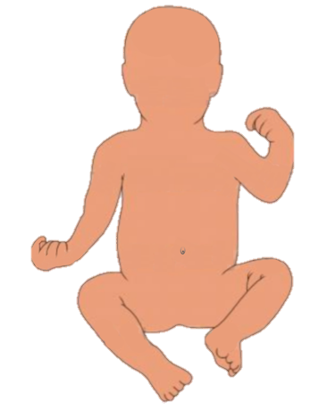

Pompe Disease Continuum
Signs and symptoms can occur from early infancy through adulthood¹
This continuum of disease is also associated with variable rates of disease progression, organ involvement, and severity^{2,3}
The continuum of phenotypes creates some ambiguity when it comes to classifying different subtypes³
Infantile-onset Pompe disease (IOPD)
Late-onset Pompe disease (LOPD)
IOPD
Pompe Disease Continuum^{2,3}
LOPD
Rapidly progressive and often fatal by 1 year of age
Gradually progressive
and often fatal
1. Technical Briefs, No. 12. Ratko TA, et al. Rockville (MD): Agency for Healthcare Research and Quality (US); 2013 Jan. Available at https://www.ncbi.nlm.nih.gov/books/NBK117221/table/background.t1/; 2. Hirschhorn R, Reuser AJJ. New York: McGraw Hill, 2001:3389–3420; 3. Kohler L, et al. Neurotherapeutics 2018;15(4):928–942. IOPD, infantile-onset Pompe disease; LOPD, late-onset Pompe disease.
MAT-US-2024340 v4.0 - P
Expiration Date: 4/1/2027
For use by Sanofi Medical Affairs for scientific and medical discussions only. Do not photograph, copy or distribute.
3

Slide 4
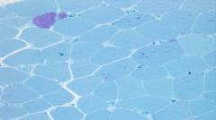

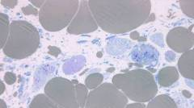
Disease Progression Leads to Lysosomal Rupture, Functional Disability, and Death
Glycogen accumulation begins early and may precede clinically detectable symptoms^{1,2}
Visualizing Progression of Disease in Muscle Tissue
Functional Muscle
Few glycogen-filled lysosomes
Dysfunctional Muscle
Glycogen accumulation visible within lysosomes
Damaged Muscle
Lysosomal swelling, rupture, irreversible damage
IRREVERSIBLE
MUSCLE DAMAGE
SYMPTOM
ONSET
Early muscle impairment may not be clinically detectable
Progressive muscle weakness, cardiomyopathy and motor delay
Progressive cardiorespiratory failure and death
Muscle biopsy images courtesy of Beth Thurberg, Sanofi Genzyme.
1. van der Ploeg AT and Reuser AJ. Lancet 2008;372:1342–1353; 2. Yang C-F, et al. Am J Med Genet Part A 2013;164A:54–61.
MAT-US-2024340 v4.0 - P
Expiration Date: 4/1/2027
For use by Sanofi Medical Affairs for scientific and medical discussions only. Do not photograph, copy or distribute.
4

Slide 5

Incidence of Pompe Disease
As Pompe disease is rare, its true incidence is difficult to estimate
Reported estimates of incidence range from 1 in 14,000 to 1 in 300,000, depending on the geographic area or ethnic group examined¹
LOPD may have a comparatively high incidence in the Netherlands²
IOPD appears to be more common among African-Americans and in southern China and Taiwan¹
The combined incidence of Pompe disease is estimated at 1 in 40,000 worldwide²
Newborn screening in the United States has revealed an incidence as high as 1:9625 ³
1. Hirschorn R, Reusr AJJ. New York: McGraw Hill, 2001:3389–3420; 2. Ausems MG, et al. Eur J Hum Genet 1999;7(6):713–716.
3. Bodamer et al Pediatrics 2017; July; 140(Supp):S4-S13
IOPD, infantile-onset Pompe disease; LOPD, late-onset Pompe disease.
MAT-US-2024340 v4.0 - P
Expiration Date: 4/1/2027
For use by Sanofi Medical Affairs for scientific and medical discussions only. Do not photograph, copy or distribute.
5

Slide 6
Infantile-Onset Pompe Disease (IOPD):
Patient Presentation
MAT-US-2024340 v4.0 - P
Expiration Date: 4/1/2027
For use by Sanofi Medical Affairs for scientific and medical discussions only. Do not photograph, copy or distribute.
6

Slide 7

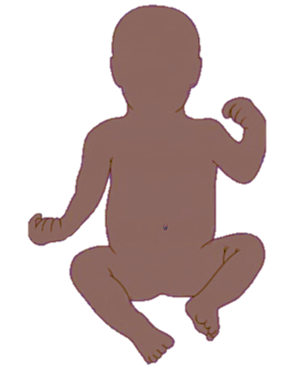
Signs and Symptoms of IOPD Affect Multiple Organ Systems
IOPD infants typically present with cardiomegaly, hypotonia, rapidly progressive skeletal, smooth, and ventilatory muscle weakness, feeding difficulties, and failure to thrive.^{1,2}
Respiratory
Progressive respiratory muscle involvement
Frequent respiratory infections
Sleep-disordered breathing
Musculoskeletal
Progressive muscle weakness
Profound hypotonia / head lag / “floppy baby”
Delayed motor milestones
Cardiac
Cardiomegaly
Progressive cardiomyopathy
Gastrointestinal
Macroglossia
Feeding difficulties
Failure to thrive / poor weight gain
Hepatomegaly
1. Kishnani PS, et al. Genet Med 2006;8(5):267–288; 2. Marsden D. Genet Med 2005;7(2):147–150.
IOPD, infantile-onset Pompe disease.
MAT-US-2024340 v4.0 - P
Expiration Date: 4/1/2027
For use by Sanofi Medical Affairs for scientific and medical discussions only. Do not photograph, copy or distribute.
7

Slide 8

Cardiac Manifestations -IOPD
      The effects of glycogen accumulation are very pronounced in the heart
The cardiac response to glycogen accumulation can result in:
Hypertrophic cardiomyopathy, or
Hypertrophic and dilated cardiomyopathy
Interference with specialized conducting tissues produces a shortening of the
atrio-ventricular (PR) interval* on the ECG
These conduction abnormalities, in conjunction with the hypertrophic cardiomyopathy, place these patients at high risk of tachyarrhythmia and sudden death, especially in situations of stress such as infection, fever, dehydration and anesthesia
Kishnani PS, et al. Genet Med 2006;8(5):267–288.
ECG, electrocardiogram.
*In ECG, the PR interval is the duration between the beginning of the P wave (the onset of atrial depolarization) until the beginning of the QRS complex (the onset of ventricular depolarization).
MAT-US-2024340 v4.0 - P
Expiration Date: 4/1/2027
For use by Sanofi Medical Affairs for scientific and medical discussions only. Do not photograph, copy or distribute.
8

Slide 9
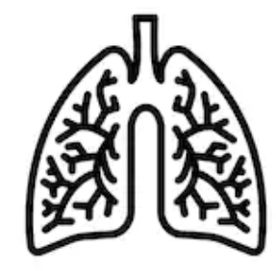



Pulmonary Manifestations -IOPD
Disease progression in patients with the IOPD is rapid and results in weakening of respiratory muscles, leading to:
Low lung volumes
An impaired cough
Respiratory insufficiency
Sleep-disordered breathing
Correlation has been observed between measures of pulmonary function and proximal muscle weakness
Impaired cough results in retained secretions and an inability to clear both the normal volume of pulmonary secretions as well as those associated with acute infections, thereby predisposing the patient to developing
atelectasis and pneumonia
Patients with IOPD are especially vulnerable to left lower lobe atelectasis secondary to the enlarged heart compressing the left main stem bronchus
Progressive respiratory insufficiency
occurring due to chronic CO₂ retention and hypoxemia* as muscle weakness progresses
Sleep-disordered breathing often presents in patients with respiratory muscle weakness because of the mechanical disadvantage of the supine position and the effect of sleep
on respiratory control mechanisms
Kishnani PS, et al. Genet Med 2006;8(5):267–288.
CO₂, carbon dioxide; IOPD, infantile-onset Pompe disease; SDB, sleep-disordered breathing.
*Hypoxemia is a condition that arises due to decreased arterial pO₂ and oxygen saturation.
MAT-US-2024340 v4.0 - P
Expiration Date: 4/1/2027
For use by Sanofi Medical Affairs for scientific and medical discussions only. Do not photograph, copy or distribute.
9

Slide 10
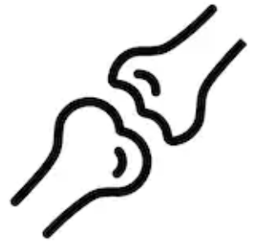



Musculoskeletal Manifestations- IOPD
Motor development is significantly delayed
Profound generalized weakness can limit all movement
or most antigravity movement
Major developmental milestones, such as the ability
to roll over, sit, or stand, are often not achieved
Kishnani PS, et al. Genet Med 2006;8(5):267–288.
MAT-US-2024340 v4.0 - P
Expiration Date: 4/1/2027
For use by Sanofi Medical Affairs for scientific and medical discussions only. Do not photograph, copy or distribute.
10

Slide 11

Gastrointestinal Manifestations- IOPD
Patients with Pompe disease have feeding and swallowing difficulties and often fail to thrive
In IOPD, contributing factors include:
Facial hypotonia,
Macroglossia and/or tongue weakness,
Poor oral range of motion with extremely limited tongue elevation
Decreased ability to achieve tongue cupping and lip seal for sucking
Patients with Pompe disease are at increased risk for aspiration
Kishnani PS, et al. Genet Med 2006;8(5):267–288.
IOPD, infantile-onset Pompe disease
MAT-US-2024340 v4.0 - P
Expiration Date: 4/1/2027
For use by Sanofi Medical Affairs for scientific and medical discussions only. Do not photograph, copy or distribute.
11

Slide 12
Gastrointestinal Manifestations (2) -IOPD
As patients with IOPD age, speech and swallow involvement evolves; particularly with food introduction and language development.
Patients with Pompe disease have progressive facial muscle weakness often with open mouth posture, ptosis, and tongue protrusion.
Clinical manifestations include:
Inability to clear food from the mouth, food becoming “stuck”
Jaw fatigue with certain food textures (meat, etc)
Inability to clear secretions; drooling
Increased risk for aspiration
Patients with Pompe disease often demonstrate hypernasal speech with limited intelligibility
Kishnani PS, et al. Genet Med 2006;8(5):267–288.
IOPD, infantile-onset Pompe disease
MAT-US-2024340 v4.0 - P
Expiration Date: 4/1/2027
For use by Sanofi Medical Affairs for scientific and medical discussions only. Do not photograph, copy or distribute.
12

Slide 13
Late-Onset Pompe Disease (LOPD):
Patient Presentation
MAT-US-2024340 v4.0 - P
Expiration Date: 4/1/2027
For use by Sanofi Medical Affairs for scientific and medical discussions only. Do not photograph, copy or distribute.
13

Slide 14







Signs and Symptoms of Late-Onset Pompe Disease Affect Multiple Organ Systems
Musculoskeletal ^{2–4}
  Proximal muscle weakness
  Muscle pain
  Frequent falls
  Gait abnormalities
  EMG abnormalities
  Elevated CK
  MRI changes
  Scoliosis/
  scapular winging
  Ptosis
Respiratory ¹
  Respiratory failure/
  insufficiency
  Diaphragm weakness
  Sleep-disordered breathing
  Orthopnea
  Dyspnea
Cardiac
  Less common among adults^{5,6}
Gastrointestinal ^{2,7}
  Difficulty chewing/
  jaw muscle fatigue
  Poor weight gain/maintenance
  Swallowing difficulties/weak tongue
  Gastroesophageal reflux
1. Van der Ploeg et al. Lancet. 2008;372(9646):1342–1353; 2. Cupler et al. Muscle Nerve 2012;45(3):319–333; 3. Alejaldre et al. Neuromuscul Disord 2012;22 Suppl 2; S148–S154; 4. Hobson-Webb et al. Clin Neurophysiol 2011;122:2312-2317; 5. Soliman et al J Intern Med 2008;264:333-339; 6. van der Beek et al. J Neurol Sci 2008;75:46-50; 7. Hobson-Webb et al. Neuromuscul Disord 2013;23(4):319-323.
MAT-US-2024340 v4.0 - P
Expiration Date: 4/1/2027

Slide 15
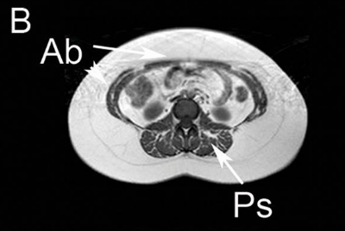
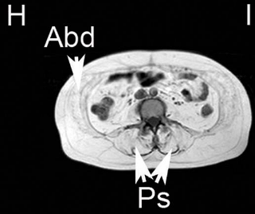

Musculoskeletal Manifestations -LOPD
  Skeletal muscle weakness is typically distributed in a limb-girdle pattern which deteriorates over time²
    Proximal > distal
    Lower extremities > upper extremities
  Symptoms include:
    Weakness
    Exercise intolerance, fatigue
    Abnormal gait
    Difficulty moving against gravity
T1w Muscle MRI of patients with Pompe disease³
Patient B is pre-symptomatic with hyperCKemia and shows mild fatty infiltration in Paraspinal muscles (Ps) and lateral abdominal muscles (Ab). Patient H who is symptomatic shows more fatty infiltration of these muscles (Ab and Ps)
1. Kishnani PS, et al. Genet Med 2006;8(5):267–288; 2. van der Beek NA, et al. Orphanet J Rare Dis 2012;7:88
Adapted from Fig 3, Figueroa-Bonaparte S. et al 2016 PLoS One 11(10):e0163493.
MAT-US-2024340 v4.0 - P
Expiration Date: 4/1/2027

Slide 16
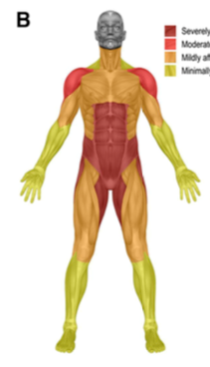
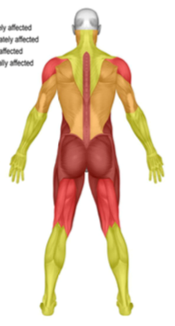
Musculoskeletal Involvement -LOPD
  Muscle involvement in Pompe is typically described as “limb girdle”
  Greatest weakness in:
    Hip extension
    Hip abduction
    Hip adduction
    Abdominals and paraspinals
  Secondary musculoskeletal impairments such
  as contracture, deformity, and osteoporosis can occur and further compromise function
  Gait displays typical posterior pelvic tilt with kyphosis
  Patients may have other unfamiliar features:
    Ptosis, bulbar weakness, scapular winging
Distribution of Musculoskeletal Weakness
Severely affected
Moderately affected
Mildly affected
Minimally affected
1. Kishnani PS, et al. Genet Med 2006;8(5):267–288. 2. van der Beek NA, et al. Orphanet J Rare Dis 2012;7:88. 3. Case LE et al. Genet Med. 2006;8(5):318-327;
MAT-US-2024340 v4.0 - P
Expiration Date: 4/1/2027

Slide 17

Pulmonary Manifestations -LOPD
  As LOPD progresses, the muscles weaken leading to low lung volumes, an impaired cough, blood gas abnormalities, and sleep-disordered breathing
    Patients with LOPD have a gradual onset of respiratory compromise that is less severe than is seen in IOPD
  Respiratory symptoms may occur without significant proximal muscle weakness
  Approximately 60% of patients with LOPD have a mild reduction in vital capacity (<80% predicted) and 30–40% have moderate reduction (<60% predicted)
  Correlation has been observed between measures of pulmonary function and proximal muscle weakness
Kishnani PS, et al. Genet Med 2006;8(5):267–288.
LOPD, late-onset Pompe disease; SDB, sleep-disordered breathing.
MAT-US-2024340 v4.0 - P
Expiration Date: 4/1/2027

Slide 18
Etiology of Pulmonary Morbidity in Pompe Disease -LOPD
  Progressive loss of pulmonary function.
  Propensity for diaphragm involvement
  Impaired cough due to abdominal muscle weakness
  Predisposes patients to development of atelectasis and pneumonia
  Sleep disordered breathing
    Occurs in all neuromuscular diseases
    May be more pronounced in Pompe disease due to diaphragm weakness
  Progressive respiratory insufficiency
    Manifest as elevated blood CO₂ level
    Respiratory failure can occur despite preserved peripheral muscle function
Johnson et al. Neuromuscl Dis 26 (2016) 136-145
CO₂, Carbon dioxide
MAT-US-2024340 v4.0 - P
Expiration Date: 4/1/2027

Slide 19

Cardiac Manifestations -LOPD
  LOPD usually occurs without significant cardiac involvement¹
  However, whilst patients with LOPD lack the cardiomyopathy seen in infants, they are at risk for arrhythmias¹
For those patients with LOPD diagnosed through NBS and who have a copy of the c.-32-13T>G variant, cardiac monitoring for arrhythmias may be warranted based on clinical indication/published monitoring recommendations²
Arrhythmias have been reported in ~15% of patients with LOPD²
1. Kohler L, et al. Neurotherapeutics 2018;15(4):928–942; 2. Herbert M, et al. J Pediatr 2018;198:308–312.
ECG, electrocardiography; LOPD, late-onset Pompe disease; NBS, newborn screening.
MAT-US-2024340 v4.0 - P
Expiration Date: 4/1/2027

Slide 20

Gastrointestinal Manifestations -LOPD
Oropharyngeal dysphagia and GI disturbances (e.g. bloating, constipation, diarrhea, abdominal pain, incontinence) can occur in LOPD^{1,2}
Patients are also at increased risk for aspiration³
Bulbar muscle involvement, including lingual weakness is a documented symptom and may occur early in disease process. ⁴
Speech quality can be affected and progress to dysarthria. ⁵
1. Hobson-Webb LD, et al. Neuromuscul Disord. April 2013;23(4):319–323; 2. Karabul N, et al. JIMD Rep. 2014;17:53–61; 3. Kishnani PS, et al. Genet Med 2006;8(5):267–288. 4. Muller CS et al. J Pediatr Neurol 2009;7:147–156. 5. Muller CS et al. J Pediatr Neurol 2009;7:147–156.
GI, gastrointestinal; LOPD, late-onset Pompe disease
For use by Sanofi Medical Affairs for scientific and medical discussions only. Do not photograph, copy or distribute.
MAT-US-2024340 v4.0 - P
Expiration Date: 4/1/2027
20

Slide 21
Appropriate Care Involves a Multidisciplinary Approach for Pompe Disease
Physical
Therapy
Occupational
Therapy
Neurologist
Pulmonologist
Orthopedist
Respiratory
Therapy
Psychosocial
Therapy
Appropriate management of patients with Pompe disease requires a combination of supportive therapies.
Patient
Cardiologist
Primary
Care
Physician
Genetic
Counseling
Geneticist/
Metabolic
Specialist
Pediatrician
Speech
Therapy
Nutritional
& Diet
Therapy
Illustration modified from Kishnani et al. Genet Med. 2006;8:267-288 (image does not appear in cited source).
MAT-US-2024340 v4.0 - P
Expiration Date: 4/1/2027

Slide 22

Pompe Registry
Long-term, global, confidential, observational program, sponsored by Sanofi
Established to increase the understanding of Pompe disease, track the disease, and monitor patient outcomes
Voluntary program open to all physicians managing patients with Pompe disease worldwide
Visit www.registrynxt.com for more information
Byrne BJ, et al. Mol Genet Metab 2011;103:1–11.
For use by Sanofi Medical Affairs for scientific and medical discussions only. Do not photograph, copy or distribute.
MAT-US-2024340 v4.0 - P
Expiration Date: 4/1/2027
22

Slide 23
Summary
Pompe disease is a rare and potentially fatal muscle disorder
Pompe disease is a Continuum raging from rapidly progressive IOPD with symptoms onset before one year of age with cardiomyopathy to gradually progressive LOPD
Glycogen accumulation progressively impairs skeletal, respiratory, and smooth muscle and cardiac function
Multidisciplinary care is recommended given the progressive and multisystemic nature of Pompe disease
IOPD, infantile-onset Pompe disease; LOPD, late-onset Pompe disease.
For use by Sanofi Medical Affairs for scientific and medical discussions only. Do not photograph, copy or distribute.
MAT-US-2024340 v4.0 - P
Expiration Date: 4/1/2027
23

Slide 24
Thank You
For use by Sanofi Medical Affairs for scientific and medical discussions only. Do not photograph, copy or distribute.
MAT-US-2024340 v4.0 - P
Expiration Date: 4/1/2027

